Slide 1
EQUITY CAPITAL
Equity capital is funds paid into a business by investors in exchange for common or preferred stock.
Equity capital= Total No. of share * Face value
Equity capital= 10cr * 10rs
=100cr
Example:-
Capital structure of SBI
2016 -2017
Equity capital= Total No. of share * Face value
Equity capital= 797.43cr * 1rs
= 797.43cr

Slide 2
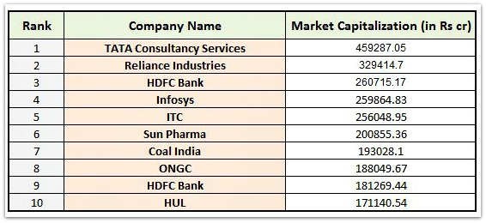
MARKET CAPITALISATION
The value of a company that is traded on the stock market, calculated by multiplying the total number of shares by the present share price.
The formula for market capitalization is:
Market Capitalization = Current Stock Price x No. of Shares
=100 * 10cr
=1000cr

Slide 3
MARKET CAPITALISATION
Small Cap
Medium Cap
Large Cap
Most small-cap companies are either start-up enterprises or companies in the development stage.
The market capitalization of these companies is less than 5000cr.
This is exactly what makes small-cap stocks a big winner for investors with a long investment horizon and a moderate-to-high risk.
Information on these companies isn’t easily available to all.
Examples of small cap companies Addi Industries Ltd., Vijaya Bank, Adhunik Metaliks Ltd. etc
These stocks are the first class in market capitalization.
The market capitalization of these companies is very high – above Rs20,000cr.
Large-cap companies have strong market presence and their stocks are generally considered to be very safe (low risk).
information on large-cap companies is very readily available.
examples of large-cap companies include Wipro, TCS, and Infosys, among others.
Mid-cap companies can be considered to border large-cap and small-cap companies on both ends of the market capitalization spectrum.
market capitalization lies between Rs5,000-20,000cr.
What attracts investors to mid-cap stocks is the possibility of investing in a company that could become an overnight success.
a lot of information on mid-cap companies isn’t publicly available.
Examples of midcap companies Apollo Tyres Ltd, Bank Of India, PC Jeweller Ltd.,etc

Slide 4
SHARE HOLDERS RIGHTS
Voting Power on Major Issues
Ownership in a Portion of the Company
The Right to Transfer Ownership
An Entitlement to Dividends
Opportunity to Inspect Corporate Books and Records
The Right to Sue for Wrongful Acts

Slide 5
CIRCUIT LIMIT
When the volatility of a stock breaks a certain limit as decided by the exchange, trading in that stock is stopped for some time is called circuit limit.
The limit is fixed as a percentage of the stock’s price by the stock exchange.
The rules for circuit breaking are decided by the Securities exchange Board(SEBI).
There are mainly two types of circuit.
CIRCUIT
UPPER CIRCUIT
LOWER CIRCUIT

Slide 6
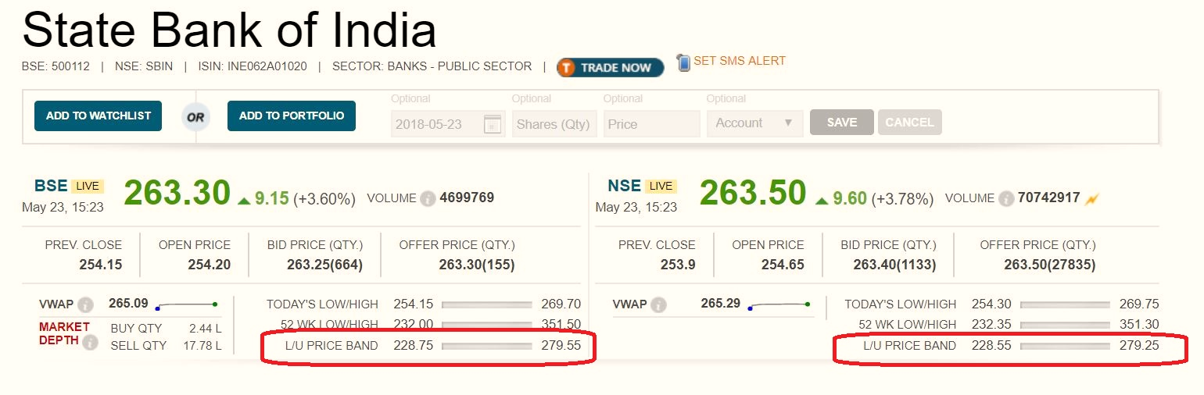
UPPER CIRCUIT & LOWER CIRCUIT
Upper circuit
Means the maximum price limit at which share stock price may move positive for intraday.
Lower circuit
Means the minimum price limit at which share price can move negative for intraday.

Slide 7
CIRCUIT FOR STOCKS
the percentage for circuit filter limit is 2%, 5%, 10%, 20%. Not all stocks fall in the circuit limit category.
If Circuit limit crosses for individual stock then it remains closed for the day.
There are stocks to which circuit limits are not applicable.
Circuit Condition
Circuit is not applicable on those share whose derivative is available
and the stock which are listed on today also circuit is not applicable.
On 22 Jan,2016, due to a bad news Interglobe Aviation(Indigo)'s share price tumbled by 20% and it couldn't go lesser than that. This allowed the market to settle, thus preventing the erosion of the rest investor's wealth.

Slide 8
CIRCUIT FOR INDICES
Trigger limit | Trigger time | Market halt duration | Pre-open call auction session post market halt
10% | Before 1:00 pm. | 45 Minutes | 15 Minutes
 | At or after 1:00 pm upto 2.30 pm | 15 Minutes | 15 Minutes
 | At or after 2.30 pm | No halt | Not applicable
15% | Before 1 pm | 1 hour 45 minutes | 15 Minutes
 | At or after 1:00 pm before 2:00 pm | 45 Minutes | 15 Minutes
 | On or after 2:00 pm | Remainder of the day | Not applicable
20% | Any time during market hours | Remainder of the day | Not applicable
For example, the BSE Sensex moved up by 2110.79 points on May 18, 2009 after the Parliament election results were announced. The trading had to be halted since the market became extremely volatile and moved beyond reasoning.

Slide 9
DEPOSITERY
Depository is an institution which holds your Shares, Government Bonds, Mutual funds etc.
National securities Depository Limited (NSDL), is a depository service promoted by some giant institutions including IDBI Bank, UTI, NSE and some other institutions.
It was established on 8 November 1996 as the first electronic securities depository in India.
Central Depository Services Limited (CDSL), is a depository service that works for the Bombay Stock Exchange (BSE) and is promoted by the State Bank of India (SBI), Bank of India, Bank of Baroda, HDFC Bank, Standard Chartered Bank, Axis Bank and the Union Bank of India.
CDSL began its operations from February 1999 onwards after obtaining prior clearance from market watchdog Securities and Exchange Board of India (SEBI)
Depository
NSDL
CDSL

Slide 10
BENEFITS OF HOLDING SECURITIES IN CDSL & NSDL:
A safe and convenient way to hold securities;
Immediate transfer of securities;
No stamp duty on transfer of securities;
Elimination of risks associated with physical certificates such as bad delivery, fake securities, delays, thefts etc.;
Reduction in paperwork involved in transfer of securities;
Reduction in transaction cost;
No odd lot problem, even one share can be sold;
Nomination facility;
Change in address recorded with DP gets registered with all companies in which investor holds securities electronically eliminating the need to correspond with each of them separately;
Transmission of securities is done by DP eliminating correspondence with companies;
Automatic credit into demat account of shares, arising out of bonus/split/consolidation/merger etc.
Holding investments in equity and debt instruments in a single account

Slide 11
Benefits of holding demat securities in CDSL & NSDL:
As the share certificates are in an electronic format, the investor is safe from the risk of theft, loss or damage to the physical share certificates.
The investor need not be skeptical about the genuineness of the securities purchased as the securities in the depository cannot be returned under objection for any reason, and it also eliminates the risk of bad delivery.
The securities are immediately transferred to the investor’s account as soon as the payment is transferred to the company’s account. There is no need for the investor to wait for the registration process from the company or its Registrar.
The stock exchanges follow the method of T+2 rolling settlement cycle, i.e. settlement of trades is done on the 2nd working day from the trade. This action is possible because dematerialized securities have paved the way for liquidity and swift transfer of securities.
No stamp duty is applicable for investors when transferring securities in dematerialized format.
Companies can directly credit their investors account in case of bonus issue or rights issue of shares.
Any update or changes in the personal information or transmission of the BO can be directly updated with the depositories. A single standing instruction to the CDSL or NSDL would help the investor update their details with all companies in which they have a vested interest.
The CDSL & NSDL, also sends the investor a statement that consolidates the position of all their holdings. This would enable investors to make informed decisions about their financial strategy.

Slide 12
ISIN
An International Securities Identification Number (ISIN) uniquely identifies a security.
The International Security Identification Number (ISIN), is a 12 Digit alpha-numeric code that uniquely identifies a security across the world.
It is designed by the United Nations ISO (International Organization for standardization) to create a single global code to identify a security.
Features Of ISIN
Used to keep track of institutional investors in a format which is consistent across the world.
Designed by ISO (International Organization Of standardization)
ISIN is issued by National Numbering Agency (NNA)
SEBI Acts as NNA in India
Example:-
SBI ISIN: INE062A01020

Slide 13
Dematerialization & Rematerialization
Dematerialization is the process by which an investor can get physical certificates converted into electronic form maintained in an account with the Depository Participant.
Rematerialization is the process of converting securities held in a electronic form in a demat account in to paper form i.e. physical certificates.
Benefits?

Slide 14
FREEZING AND UNFREEZING
A depository account holder (beneficiary account) may freeze securities lying in the account for as long as the account holder wants it.
By freezing the account, account holder can prevent unexpected debits or credits or both, creeping into its account.
Once freezed the account can be unfreezed only on the instruction of the account holders.

Slide 15

SECURITIES AND EXCHANGE BOARD OF INDIA (SEBI)
The SEBI i.e. Securities and Exchange Board of India is the regulator for all the security markets in India.
It was established in the year 1988 and given statutory powers on 30 January 1992 through the SEBI Act, 1992.
SEBI has its Head Quarters at the business district of Bandra Kurla Complex in Mumbai, and has regional offices in New Delhi, Kolkata, Chennai and Ahmedabad.
SEBI is managed by the following members of the board:
  The Chairman who is nominated by the Union Government of India.
  Two members from the Union Finance Ministry
  One member from the Reserve Bank of India
  The remaining 5 members are nominated by the Union Government of India, out of them.

Slide 16
OBJECTIVES OF SEBI
Investor Protection
Regulation of Stock Markets
Checking for Insider Trading
Control over Financial Intermediaries

Slide 17
POWERS OF SEBI
1. Powers relating to stock exchanges & intermediaries
SEBI has wide powers regarding the stock exchanges and intermediaries dealing in securities. It can ask information from the stock exchanges and intermediaries regarding their business transactions for inspection or scrutiny and other purpose.
2. Power to impose monetary penalties
SEBI has been empowered to impose monetary penalties on capital market intermediaries and other participants for a range of violations. It can even impose suspension of their registration for a short period.
3. Power to initiate actions in functions assigned
SEBI has a power to initiate actions in regard to functions assigned. For example, it can issue guidelines to different intermediaries or can introduce specific rules for the protection of interests of investors.
4. Power to regulate insider trading
SEBI has power to regulate insider trading or can regulate the functions of merchant bankers.
5. Powers under Securities Contracts Act
For effective regulation of stock exchange, the Ministry of Finance issued a Notification on 13 September, 1994 delegating several of its powers under the Securities Contracts (Regulations) Act to SEBI.
SEBI is also empowered by the Finance Ministry to nominate three members on the Governing Body of every stock exchange.
6. Power to regulate business of stock exchanges
SEBI is also empowered to regulate the business of stock exchanges, intermediaries associated with the securities market as well as mutual funds, fraudulent and unfair trade practices relating to securities and regulation of acquisition of shares and takeovers of companies.

Slide 18
INSIDER TRADING
Insider Trading
It is the buying and selling of securities based on information that has not been made available to the general public.
It is illegal.
Unfair to other investors who do not have access to the information.
Penalty For Insider Trading
He shall be liable to a penalty of twenty-five crore rupees or three times the amount of profits made out of insider trading, whichever is higher.
The Act of 2013 provides for jail term up to five years if any person contravenes the provisions of S 195.
Example
  HINDUSTAN LIVER LIMITE V. SEBI
  The facts of the case concerned the purchase by HLL of 8 lakh shares of BBLIL from the Unit Trust of India (UTI) on March 25, 1996. This purchase was made barely two weeks prior to a public announcement for a proposed merger of HLL with BBLIL.
  Upon investigation, SEBI by its Order dated March 11, 1998 (Order) found that, at the time of the purchase of shares of BBLIL from UTI, HLL was an “insider” as under Section 2(e) of the 1992 Regulations.

Slide 19
DIVIDEND
Definition:-
A dividend is a payment made by a corporation to its shareholders, usually as a distribution of profits.
Most companies having stable and secure growth offer dividends when their share prices become stagnant.
several companies do not offer dividends as all profits are reinvested to ensure faster, better-than average growth.
The board of directors decides the percentage of the profit to be distributed as dividends.
Dividends are issued quarterly or annually.
Criteria:-
To be eligible for a dividend, you must purchase the stock during or prior to the cum-dividend trading period and h
Example:-
COMPANY NAME | DIVIDEND |  | DATE
 | Type | % | Announcement | Record | Ex-Dividend
HDFC Bank | Final | 650.00 | 23-04-2018 | 01-06-2018 | 31-05-2018

Slide 20
Dividend Declaration Date:-
The date on which the next dividend payouts would be done, is announced by the directors of the company.
This usually have information on the size of the dividend payout, ex-dividend date, record date and payout date.
Ex-Dividend Date:-
It’s the time between the announcement done and the payment of the dividend.
It usually precedes the record date. At times it is one business day before the record date.
Record Date:-
Record date is the date which is used to payout dividend to investors.
For getting dividend, investor’s name should be present on records of the company as the holder of shares.
basically this date decides which all investors are eligible for dividend payouts.

Slide 21
BENEFITS OF DIVIDEND
INVESTOR PREFERENCE FOR DIVIDENDS
  The investors are more interested in a company that pays stable dividends. This assures them of a reliable source of earnings, even if the market price of the share dips.
BIRD-IN-HAND FALLACY
  This theory states that the shareholders prefer the certainty of dividends in comparison to the possibility of higher capital gains in future.
STABILITY
  Investors prefer companies that have a track record of paying dividends as it reflects positively on its stability. This indicates predictable earnings to investors and thus, makes the company a good investment.
BENEFITS WITHOUT SELLING
  Investors invested in dividend-paying stocks do not have to sell their shares to participate in the growth of the stock. They reap the monetary benefits without selling the stock.
TEMPORARY EXCESS CASH
  A mature company may not have attractive venues to reinvest the cash or may have fewer expenses related to R&D and expansion. In such a scenario, investors prefer that a company distributes the excess cash so that they can reinvest the money for higher returns.
INFORMATION SIGNALLING
  When a company announces the dividend payments, it gives a strong signal about the future prospects of the company. Companies can also take advantage of the additional publicity they get during this time.

Slide 22
DIVIDEND TYPES
Types of Dividend
Cash
Stock
Property
Other
Regular cash dividends are paid out of a company's profit.
Stock dividend are paid in the form of additional stock share of the issuing corporation or other corporations, such as its subsidiaries.
Property dividends are paid in the form of assets from the issuing company most frequently in the form of securities.
Financial assets that have a known market value can also be distributed as dividends. These can be warrants, bonds or shares in subsidiary.

Slide 23
BONUS
Definition:-
Bonus shares are additional shares which are gifted to its shareholders.
Types:-
Bonus shares are issued in the form like-
  1:1- means 1 extra shares for 1 holding shares.
  1:2- means 1 extra shares for 2 holding shares.
  1:3- means 1 extra shares for 3 holding shares.
Why do companies give bonus share?
  To reward their investors
  To increase liquidity of the stock
  To bring the stock price in a reasonable price range.
Example:-
  TCS announced 1:1 on 19-04-2018
  What will be the impact of bonus on stock?

Slide 24
ADVANTAGE OF BONUS SHARE
ADVANTAGES OF BONUS SHARES FROM INVESTOR’S POINT OF VIEW
The investor doesn’t need to pay any tax upon receiving the bonus shares.
It is specifically beneficial for the investors who believe in the long-term story of the company and want to increase their investment in the same.
Issuing additional shares and using cash for the business growth of the company increases the investor’s belief in operations of the company.
If the company starts paying the cash dividend in the future, the investor receives more because he holds a number of shares in the company due to past policy of paying a stock dividend.
ADVANTAGES OF BONUS SHARES FROM COMPANY’S POINT OF VIEW
Bonus issue allows the company to conserve cash for reinvesting back into the business.
It has a signaling effect and gives a positive sign to the market that company believes in its long-term growth story.
Sometimes, the company may not be in a position to pay any cash, so bonus issue is the only means to satisfy the shareholders’ desire for a dividend.
Increasing the number of outstanding shares through a bonus issue increases the participation of smaller investors in the company’s shares and hence enhances the liquidity of the stock.
The Increase in the issued share capital increases the perception of company’s size.

Slide 25
BUYBACK
Definition:-
  A buyback is repurchase of shares, means company purchase their own shares from market which in turn reduces the open share in market .
Reason of Buy- Back of share-
  To Increase in the value of share.
  eliminate any threats by shareholders who may be looking for a controlling stake.
  Enhance Shareholder Value By Providing Cash Distribution.
  Increase Earnings Per Share (EPS).
  Reduce Cash Outflow.
  Make Changes in Capital Structure.

Slide 26
Benefits of buyback
1. Companies possessing large free reserves base and are willing to use funds to purchase or acquire shares and other securities under the buyback scheme, can use their funds in a wise and effective manner.
2. As share buy backs change the capital structure of the firm, sometimes share buy backs are undertaken as a counter-measure against re-issue of shares (which are made compulsorily to discharge the existing obligations) to maintain a balance, to the extent possible, in the capital structure. In other words, share repurchases are undertaken to provide shares for retirement programmes (e.g. conversion of convertible debentures, bonds etc.), exercise of stock option scheme, bonuses or other re-issue purposes.
3. Announced share repurchase programmes signal management’s positive information about the future prospects of the firm. If the management possesses favourable information, well known to themselves but not known to the market, it can distribute cash to shareholders with the anticipation that the company expects future cash flows to increase and thus as per management’s present calculations, the firm is undervalued.
4. Buy back of shares and securities helps the promoters to formulate an effective defensive strategy against hostile takeover bids.
5. Share buy backs are undertaken to increase the stake of the promoters and sometimes with the ultimate object of buying out completely the entire shareholdings of the non- promoter shareholders or at least to the extent which enables the promoters holding to cross 90% and delist the company.
6. A company cannot buy back its shares more than once in a year but there is no restriction to adopt repeated buy back deals year after year. This also paves the way of the promoters to reach their targets quickly to increase their share and more control in the companies.
7. Buyback of shares and securities results in lower capital base, enhances post-buyback earning per share and appreciates considerably the price-earnings ratio.
8. Buyback of shares & securities is allowed under section 77B, if the liquidity position of the company is good. Companies which have defaulted in repayment of deposits, redemption of debentures or preference shares or repayment of term loans or interest payable thereon, from banks and financial institutions are not allowed buyback shares. It is a good check on the companies with unhealthy liquidity position.
9. After buyback of shares the companies will have the advantage of servicing a reduced capital base with higher dividend yield.

Slide 27
RIGHTS ISSUE
A rights issue is when a company issues its existing shareholders a right to buy additional shares in the company.
The shares are often offered at a discounted price to encourage existing shareholders to take the company up on their offer.
The company will offer the shareholder a specific number of shares at a specific price.
The company will also set a time limit for the shareholder to buy the shares.
Example:-
  Company-Tata Steel
  Announced-20-12-17
  Rights Ratio-2:25

Slide 28
Advantage of right issue
  Advantages of Rights Issue:
  i. To Companies:
  The company benefits from lower issue costs, in that administration and underwrit­ing costs are lower and the issue is made at the direction of the directors rather than via a general meeting of the company. This is because issues of equity through the stock exchange will alter the balance of ownership.
  ii. To the Shareholders:
  The main attraction of the rights issue for current shareholders is that they are able to maintain their original proportion of share ownership. Furthermore, any transfer of wealth away from them due to an equity issue being under priced, is avoided.

Slide 29
STOCK SPLIT
Definition:-
  A stock split or stock divide increases the number of shares in a company.
  The price is adjusted such that the before and after market capitalization of the company remains the same.
  when the market price per share is so high that it becomes unwieldy when traded
Example:-
  Company-Phillips Carbon Black Ltd
  Announced-31-01-2018
  Old face value-10
  New face value-2

Slide 30
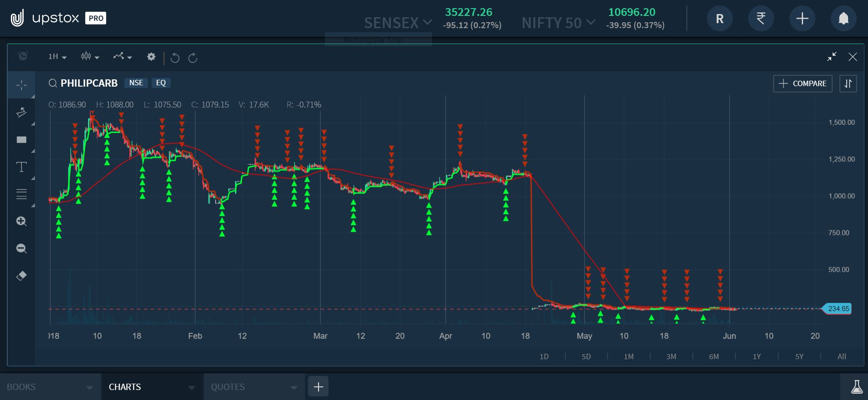

Slide 31
FOLLOW-ON PUBLIC OFFERING(FPO)
  Follow-on Public Offering, as the name suggests it is the public issue of shares to investors at large, by a publicly listed company.
  The process is after an IPO; wherein the company goes for a further issue of shares to the general public with a view to diversifying their equity base.
  The shares are offered for sale by the company through an offer document called prospectus.
  There is two type of Follow-on Public Offering:
    Dilutive offering
    Non-Dilutive offering

Slide 32
COMPARISON BETWEEN IPO & FPO
BASIS FOR COMPARISON | IPO | FPO
Meaning | Initial Public Offering (IPO) refers to an offer of securities made to the public for subscription, by the company. | Follow-on Public Offering (FPO) means an offer of securities for subscription to public, by an publicly traded enterprise.
What is it? | First public issue | Second or third public issue
Issuer | Unlisted Company | Listed Company
Objective | Raising capital through public investment. | Subsequent public investment.
Risk | High | Comparatively low

Slide 33
MUTUAL FUNDS
Mutual fund is nothing but a collection of stocks or bonds that a professional fund manager buys on your behalf. The fund manager decides which/how many stocks or bonds to buy.
A mutual fund then distributes the entire investment amount in small units (called units). Investors can buy these units instead of buying stocks directly.

Slide 34
Types of Mutual Funds
1. Money Market Funds:
These funds invest in short-term fixed income securities such as government bonds, treasury bills, bankers’ acceptances, commercial paper and certificates of deposit. They are generally a safer investment, but with a lower potential return then other types of mutual funds. Canadian money market funds try to keep their net asset value (NAV) stable at $10 per security.
2. Fixed Income Funds:
These funds buy investments that pay a fixed rate of return like government bonds, investment-grade corporate bonds and high-yield corporate bonds. They aim to have money coming into the fund on a regular basis, mostly through interest that the fund earns. High-yield corporate bond funds are generally riskier than funds that hold government and investment-grade bonds.

Slide 35
3. Equity Funds:
These funds invest in stocks. These funds aim to grow faster than money market or fixed income funds, so there is usually a higher risk that you could lose money. You can choose from different types of equity funds including those that specialize in growth stocks (which don’t usually pay dividends), income funds (which hold stocks that pay large dividends), value stocks, large-cap stocks, mid-cap stocks, small-cap stocks, or combinations of these.
4. Balanced Funds:
These funds invest in a mix of equities and fixed income securities. They try to balance the aim of achieving higher returns against the risk of losing money. Most of these funds follow a formula to split money among the different types of investments. They tend to have more risk than fixed income funds, but less risk than pure equity funds. Aggressive funds hold more equities and fewer bonds, while conservative funds hold fewer equities relative to bonds.

Slide 36
5. Index Funds:
These funds aim to track the performance of a specific index such as the S&P/TSX Composite Index. The value of the mutual fund will go up or down as the index goes up or down. Index funds typically have lower costs than actively managed mutual funds because the portfolio manager doesn’t have to do as much research or make as many investment decisions.
6. Specialty Funds:
These funds focus on specialized mandates such as real estate, commodities or socially responsible investing. For example, a socially responsible fund may invest in companies that support environmental stewardship, human rights and diversity, and may avoid companies involved in alcohol, tobacco, gambling, weapons and the military.
7. Fund-of-Funds:
These funds invest in other funds. Similar to balanced funds, they try to make asset allocation and diversification easier for the investor. The MER for fund-of-funds tend to be higher than stand-alone mutual funds.

Slide 37
Thank you

