Slide 1
I INTRODUCTION TO SHARE MARKET

Slide 2
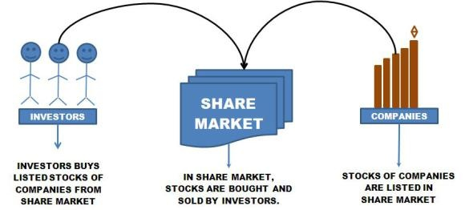
INTRODUCTION TO SHARE MARKET
What is share?
a part or portion of a larger amount which is divided among a number of people, or to which a number of people contribute.
What is share market?
A share market is where shares are either issued or traded in.
In share market ownership of company is sold to investors in form of stocks/shares .
A stock market is similar to a share market.

Slide 3
SPECULATION VS SHARE MARKET
Speculation Market
Share Market
Speculation is financial action that does not promise safety of the initial investment along with the return on the principle sum.
Speculation involves a game of chance.
Speculation have more risk.
Speculation winning ratio and loosing ratio is 50:50.
It is illegal market.
A share market is an public entity for the trading of company shares and derivatives at an agreed price.
Share market involves calculating risk and conducting research before entering a financial transaction.
Share market have less risk than speculative market.
Share market winning ratio and loosing ratio is 30:70
It is legalized market approved by SEBI.

Slide 4

WHY PEOPLE INVEST IN SHARE MARKET?
Grow Your Money
Save For Retirement
Earn Higher Returns
Reach Financial Goals
Start And Expand A Business
Support Others
Reduce Taxable Income
Be Part Of A New Venture

Slide 5

WHAT IS SAVING?
The money you earn is partly spent and the rest saved for meeting future expenses / Emergency.
Why it so Important?
Emergency cushion - This could be any number of things: a new roof for your house, out-of-pocket medical expenses, or sudden loss of income. You will need money set aside for these emergencies to avoid going into debt to pay for your necessities.
Retirement – If you intend to retire someday, you will probably need savings and/or investments to take the place of the income you'll no longer get from your job.
Average Life Expectancy – With more advances in medicine and public health, people are now living longer and needing more money to get by.
Volatility of Social Security – Social Security was never intended to be the primary source of income and should be treated as a supplement to income.
Education - The costs for private and public education are rising every year and it's getting tougher to meet these demands.

Slide 6
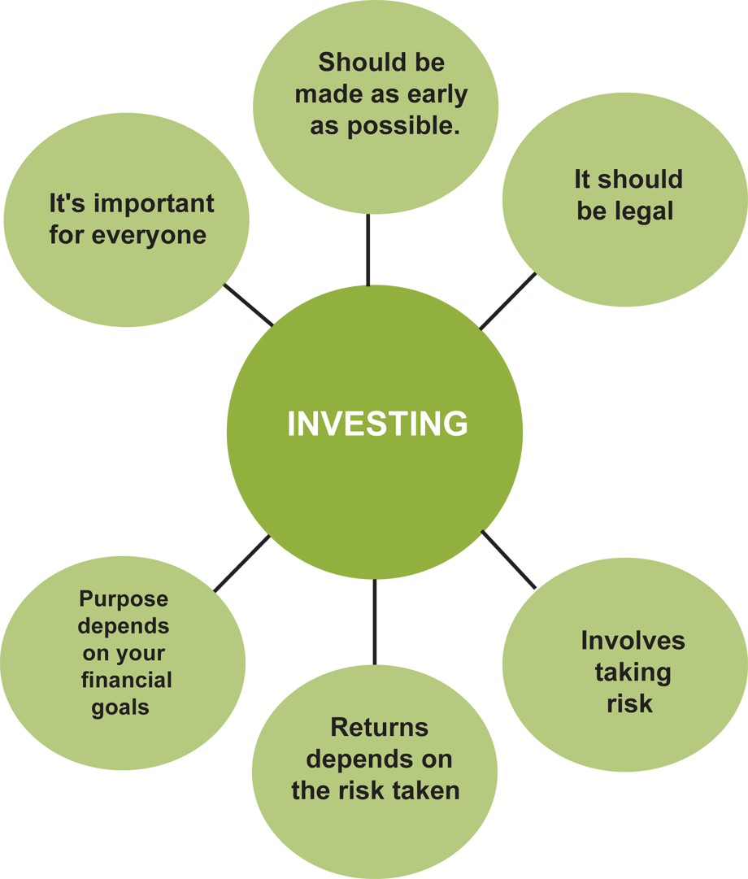
WHAT IS INVESTMENT?
Investment can be defined allocating money to assets with the hope that in the future it would provide some benefit such as generation of income.
Property and gold are some common examples of the traditional type of investment.
Why Should Invest?
Earn return on your idle resources.
Generate a specified sum money for a specific goal in life.
Make a provision for an uncertain Futures.

Slide 7
When To Start Investing?
INVESTING
Early
Regularly
Long Term
Golden Rules of Investing
Analyse your own needs and your investment consideration.
Start investing early and regularly.

Slide 8
TYPES OF INVESTMENT PERIOD
Medium Term
More than 3 Months but less than 1 years
Taxable
Long Term
More than 1 years
Taxable
1 day to 3 Months
Short Term
Tax free upto 1 lakh

Slide 9
INSURANCE
What is Insurance?
Insurance is defined as the equitable transfer of the risk of a loss, from one entity to another, in exchange for a premium, and can be thought of as a guaranteed and known small loss to prevent a large, possibly devastating loss.
An insurer is a company selling the insurance; an insured or policyholder is the person or entity buying the insurance.
The insurance rate is a factor used to determine the amount to be charged for a certain amount of insurance coverage, called the premium.
Benefits of Insurance
Financial Security of Life and Assets in case of an unfortunate event
Tax Relief by way of deductions from Income, which lowers tax burden
Encourages saving and helps in Financial Planning for the Future
Life Insurance Policies can be used as a security to obtain a Loan

Slide 10
TYPES OF INSURANCE
Types of Insurance
General insurace
Health Insurance
Life Insurance

Slide 11
GENERAL INSURANCE
Insurance contracts that do not come under the ambit of life insurance are called general insurance.
Types
Auto Insurance
Fire Insurance
Marine Insurance
Property Insurance
Travel Insurance

Slide 12


HEALTH INSURANCE
Health insurance generally covers medical expenses for health related issues that an insured person experienced.

Slide 13

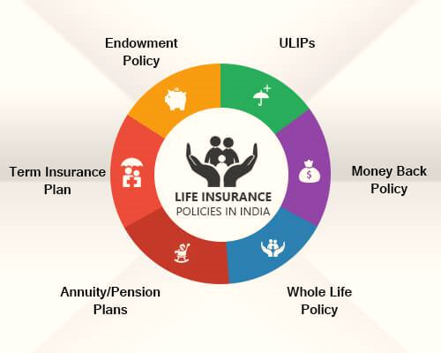
LIFE INSURANCE
Life insurance is designed to provide a financial security to the family of a policy holder in the event of his or her death.
The most common types are term life insurance and whole life insurance.
A term life insurance is easily affordable but only covers an insured person for a specific length of time.
whole life insurance is more expensive but provides coverage for the entire life of an insured person.
The insurance is not only a protection but is a sort of investment because a certain sum is returnable to the insured at the death or the expiry of a period.

Slide 14
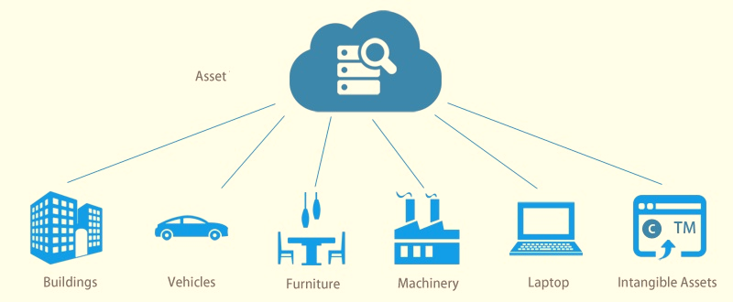
ASSET
What is Asset?
An asset is anything of value that can be converted into cash. Assets are owned by individuals, businesses and governments.
Examples of assets include:-
Cash and cash equivalents – certificates of deposit, checking and savings accounts, money market accounts, physical cash, Treasury bills;
Real property – land and any structure that is permanently attached to it;
Personal property – everything that you own that is not real property such as boats, collectibles, household furnishings, jewelry, vehicles;
Investments – annuities, bonds, cash value of life insurance policies, mutual funds, pensions, retirement plans stocks and other investments.

Slide 15
Types of Assets
Types
Intangible Asset
Financial Asset
Tangible Asset
Fixed Asset
Current Asset
Tangible assets are any assets that have a physical presence. Examples include cash, stocks, bonds, property, buildings, equipment, inventory, precious metals and art.
Intangible Assets are assets that have no physical presence. Examples include patents, copyrights, goodwill and trademarks. It is usually difficult to determine the value of intangible assets.
A financial asset is an asset that has a value that's based on a contract. Examples include cash, stocks, bonds and derivatives.
Fixed assets are long-lived assets that cannot be easily converted into cash. Examples include property, buildings, equipment and furniture.
Current assets include cash and assets that are expected to be converted into cash, consumed or expended in the next year or current operating period.

Slide 16
‘EQUITY’/EQUITY SHARE
What is equity share?
When you buy an equity share of a company, you are buying into the ownership in the business. As an equity investor, you are a partial owner of a company.
Equity is nothing but ownership; ownership in Business.
For Ex. if you hold 10 shares of XYZ Company out of total 1000 shares floated by the company – you are 1% owner in XYZ’s business.
What is shareholder?
A shareholder is any person, company or other institution that owns at least one share of a company’s stock.
shareholders are a company's owners, they reap the benefits of the company's successes in the form of increased stock valuation.
If the company does poorly, however, shareholders can lose money if the price of its stock declines.

Slide 17


EXCHANGE AND STOCK EXCHANGE
What is exchange?
an act of giving one thing and receiving another (especially of the same kind) in return.
Barter is a system of exchange where goods or services are directly exchanged for other goods or services without using a medium of exchange, such as money.
What is stock exchange?
A stock exchange or securities exchange is an exchange where stock brokers and traders can buy and sell securities, such as shares of stock and bonds and other financial instruments.

Slide 18
DIFFERENT STOCK EXCHANGES
INDIAN STOCK EXCHANGE
INTERCONNECTED STOCK EXCHANGE
WORLD STOCK EXCHANGE
Bombay Stock Exchange (BSE)
National Stock Exchange of India (NSE)
Calcutta Stock Exchange
Cochin Stock Exchange
U.P stock exchange
Vadodara Stock Exchange
Coimbatore Stock Exchange
Madras Stock Exchange (MSE)
Meerut Stock Exchange
Over the Counter Exchange of India
Ahmedabad Stock Exchange
Trivandrum Stock Exchange
Bangalore Stock Exchange
Bhubaneshwar Stock Exchange
Delhi Stock Exchange
Guwahati Stock Exchange
Hyderabad Stock Exchange
Jaipur Stock Exchange
Canara Stock Exchange
Ludhiana Stock Exchange
Multi Commodity Exchange of India
OTC Exchange of India
Pune Stock Exchange(April 2015 closed)
Madras Stock Exchange
M.P Stock Exchange
Magadh Stock Exchange
New York Stock Exchange
NASDAQ
Japan Exchange Group
Shanghai Stock Exchange
Euronext
London Stock Exchange
Hong Kong Stock Exchange
Shenzhen Stock Exchange
TMX Group
Why we need other stock exchanges except than BSE and NSE?

Slide 19
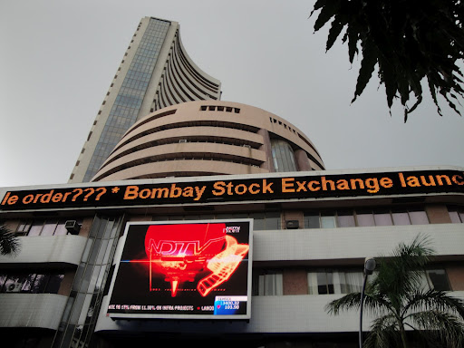
BOMBAY STOCK EXCHANGE (BSE)
BSE – Bombay Stock exchange
The oldest Stock Exchange market in Asia.
Establish in 1875.
It was recognized by government of India on Aug 31st , 1957.
In 2002, the name “the Stock Exchange Mumbai” was changed to Bombay Stock Exchange”.
The BSE Computerized its trading system by introducing Bombay on line Trading BOLT on 14.3.1995.
Bombay stock exchange index means Sensex.
Sensitive Index = Sensex.
BSE 30.
Sensex calculate from 1979.
Its Start from 100 and current its on 31700/-

Slide 20
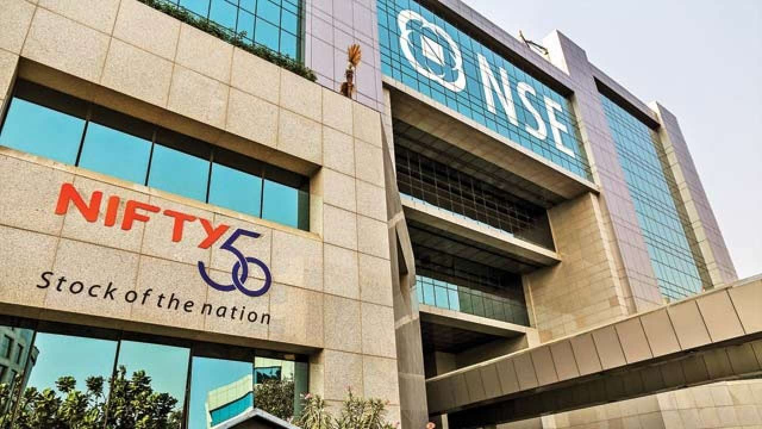
NATIONAL STOCK EXCHANGES(NSE)
NSE- National stock exchange.
The NSE was incorporated in November 1922.
Recognized stock exchange from April 26,
1993.
The NSE has a fully automated screen-based trading system.
National stock exchange index means Nifty
NSE50
It starts from 1000 and current is on 10700/-

Slide 21
DIFFERENT INDICES IN INDIA
BSE
Nifty
S&P BSE Sensex
S&P BSE SENSEX 50 Index
S&P BSE Smallcap
S&P BSE Midcap
S&P BSE SmallCap Select Index
S&P BSE MidCap Select Index
S&P BSE LargeCap
S&P BSE AllCap
S&P BSE 100
S&P BSE 200
S&P BSE 500
S&P BSE BANKEX
S&P BSE Auto
S&P BSE Basic Materials
S&P BSE Capital Goods
S&P BSE Consumer Durables
S&P BSE Energy
S&P BSE Finance
S&P BSE FMCG
S&P BSE Healthcare
S&P BSE India Mfg
S&P BSE Industrials
S&P BSE IPO
S&P BSE IT
NIFTY NEXT 50
NIFTY Midcap 100
NIFTY MIDCAP 50
NIFTY Smallcap 100
NIFTY 100
NIFTY 500
NIFTY AUTO
NIFTY BANK
NIFTY COMMODITIES
NIFTY CONSUMPTION
NIFTY ENERGY
NIFTY FIN SERVICE
NIFTY FMCG
NIFTY INFRA
NIFTY IT
NIFTY MEDIA
NIFTY METAL
NIFTY MNC
NIFTY PHARMA
NIFTY PSE
NIFTY PSU BANK
NIFTY PVT BANK

Slide 22
IPO
What is IPO?
Initial Public Offer (IPO) is a source of collecting money from the public for the first time in the market to fund for its projects. In return, the company gives the share to the investors in the company.
Why does a company offer an IPO?
To expand business
To diversify business
To fund existing project
To reduce debts
To working capital
To meet general corporate/administration expenses

Slide 23
QUALIFICATIONS FOR LISTING IPO
Paid up Capital-The paid up equity capital of the applicant shall not be less than 10 crores and the capitalization of the applicant's equity shall not be less than 25 crores.
Conditions Precedent to Listing-The Issuer shall have adhered to conditions precedent to listing as emerging from inter-alia from Securities Contracts (Regulations) Act 1956, Companies Act 1956, Securities and Exchange Board of India Act 1992, any rules and/or regulations framed under foregoing statutes, as also any circular, clarifications, guidelines issued by the appropriate authority under foregoing statutes.
At least three years track record or five years.
No disciplinary action by other stock exchanges and regulatory authorities in past three years.
Track Record of Director(s) of the Company.
The company has net tangible assets of at least Rs.3 Crores in each of the preceding 3 full year’s.
The company has net worth of at least 1cr.

Slide 24
IPO STUDY POINTS
Capital Structure.
Object of issue.
Basis for issue price.
Industries Overview.
Our Business.
Our Management.
Financial statements.

Slide 25
TYPES OF IPO
IPO
Fixed Price Issue
Book Building Issue
Fixed Price Issue
In the fixed price IPO process, the Company along with their underwriters evaluate the companies’ assets, liabilities, and every financial aspect. Then they work with these figures to fix a price per issue to achieve the target funds.
Book Building Issue
In the book building issue, the price is discovered during the process of IPO. There is no fixed price, but there is a price band. The lowest price in the band is referred to as the ‘floor price’ and the highest price is referred to as the ‘cap price’.

Slide 26
DIFFERENCES BETWEEN THE ISSUES
 | Fixed Price Issue | Book Building Issue
Pricing | The share price is fixed on the first day of issue and is printed in the order document. | The exact share price isn’t fixed. Only the price band is fixed. The price is fixed after the closing date of the bid.
Demand | It is known only after the close of issue. | It can be known every day.
Payment | The payment should be done 100% in advance. Refund is given after the allocation. | The payment can be made after the allocation.
Reservations | 50% of the allocations are reserved for investments below 2 lakhs, and the rest for high amount investors. | 50% of allocations are reserved for the QIBs. 35% for small investors and the rest to other categories of investors.

Slide 27
SALIENT FEATURES OF PUBLIC ISSUE
To Apply The Public Issue Each Investor Have His Own Demat A/c.
You Have To Apply The Public Issue In Lot Mode & Its Multiple.
Through single name multiple application are not allowed.
Minimum Allotment Is 1 Lot Size or NIL.

Slide 28
WHO DECIDES THE PRICE BAND?
Company with help of lead managers (merchant bankers or syndicate members) decides the price or price band of an IPO.
SEBI, the regulatory authority in India or Stock Exchanges do not play any role in fixing the price of a public issue. SEBI just validate the content of the IPO prospectus.
Companies and lead managers does lots of market research and road shows before they decide the appropriate price for the IPO.
Companies carry a high risk of IPO failure if they ask for higher premium.
Many a time investors do not like the company or the issue price and doesn't apply for it, resulting unsubscribe or undersubscribed issue. In this case companies' either revises the issue price or suspends the IPO.

Slide 29
HOW MANY DAYS IS THE ISSUE OPEN?
For Fixed price public issues: 3 to 10 working days.
For Book built public issues: 3 to 7 working days extendable by 3 days in case of a revision in the price band.
For Rights issues: 15 to 30 days.

Slide 30
CATEGORIES OF INVESTORS IN BOOK BUILDING
Dmart/Avenue Supermarts | Qualified institutional buyers (QIBs) | Non-institutional investors (NIIs) | Retails individual investors (RIIs)
WHO CAN APPLY | Scheduled Commercial Banks, Mutual Funds, F.I.I., State Industrial Development Corporation, Insurance Companies, Provident Funds, Pension Funds, Etc. | Companies, Corporate Bodies, Scientific Institutions, Societies, Trusts, NRI Indian Individual | Individual including HUFs
Reservation % | 50% | 15% | 35%
Share reserved | 3,12,70,902 | 9,381.271 | 21,889,633

Slide 31
HOW MANY DAYS IT TAKES TO GET REFUND OF AN IPO?
It usually takes 3 to 10 days to get IPO refunds after IPO allotments are done by the registrar of the IPO.
Refunds are usually process through two different ways:
Electronic Clearing Service (ECS):
Also known as direct deposit in bank account, this method is quickest, most convenient and hassle free.
In ECS the refund amount is directly deposited in your bank account which is available immediately.
Cheques:
Cheques are conventional way of sending refunds. This method takes a little longer as cheques takes few days to clear.
Usually cheques send through registered post through post office and takes 3 to 5 days to receive it.

Slide 32
LISTING OF SHARE ON STOCK EXCHANGE
Issue Detail:
Issue Open: Mar 8, 2017 - Mar 10, 2017
Issue Type: Book Built Issue IPO
Issue Size: 62,541,806 Equity Shares of Rs 10 aggregating up to Rs 1,870.00 Cr
Face Value: Rs 10 Per Equity Share
Issue Price: Rs 295 - Rs 299 Per Equity Share
Market Lot: 50 Shares
Minimum Order Quantity: 50 Shares
Listing At: BSE, NSE

Slide 33
How do I know when IPO shares are allotted to me?
For a public issue, you can know the status by calling the registrar (you will know about the registrar on the Highlights Page of the issue) after 30 to 40 days from the closing date of the issue.
However, in a book building issue, you can know the status by calling the registrar after 20 days from the closing date and also of course how Saksham suggested There is an email and message facility regarding the allotment status provided to the shareholders by the company as well as by the broker .

Slide 34
PRIMARY MARKET VS SECONDARY MARKET
BASIS FOR COMPARISON | PRIMARY MARKET | SECONDARY MARKET
Meaning | The market place for new shares is called primary market. | The place where formerly issued securities are traded is known as Secondary Market.
Another name | New Issue Market | After Market
Type of Purchasing | Direct | Indirect
Financing | It supplies funds to budding enterprises and also to existing companies for expansion and diversification. | It does not provide funding to companies.
How many times a security can be sold? | Only once | Multiple times
Buying and Selling between | Company and Investors | Investors
Who will gain the amount on the sale of shares? | Company | Investors
Intermediary | Underwriters | Brokers
Price | Fixed price | Fluctuates, depends on the demand and supply force
Organizational difference | Not rooted to any specific spot or geographical location. | It has physical existence.

Slide 35
IPO LISTING FROM PRIMARY TO SECONDAY MARKET
Primary
Secondary
First Time Trading Price
Mr. Rupesh buy Dmart IPO at Issue Price: Rs 295 - Rs 299 Per Equity Share.
Dmart final price: is 299
Market Lot: 50 Shares
Total Investment: 299*50=14950
BSE NSE
Open Price: 604/share 600/share
First Time Trading Price
B) Mr. Nitesh buy Quick Heal IPO at Issue Price: Rs 311 - Rs 321 Per Equity Share
Market Lot: 45 Shares
Total Investment: 321*45=14445
BSE NSE
Open Price: 304.95/share 305/share

Slide 36
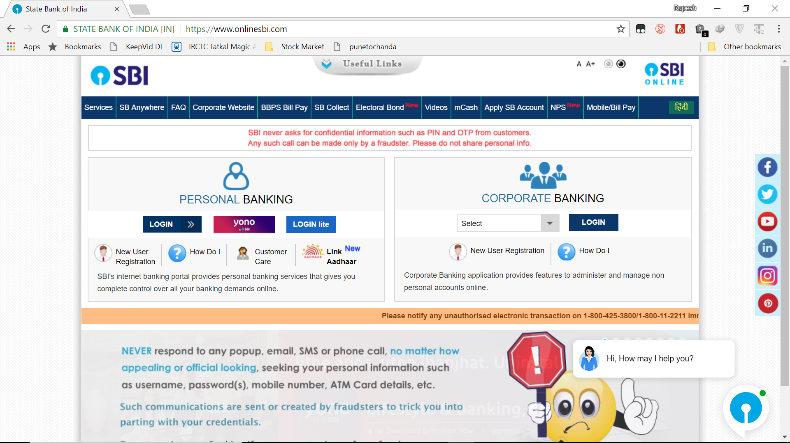
HOW TO BUY AN IPO?
You can start investing in an IPO instantly with the help of your existing online bank account.
Log in your existing internet banking.
LOG IN YOUR INTERNET BANKING

Slide 37
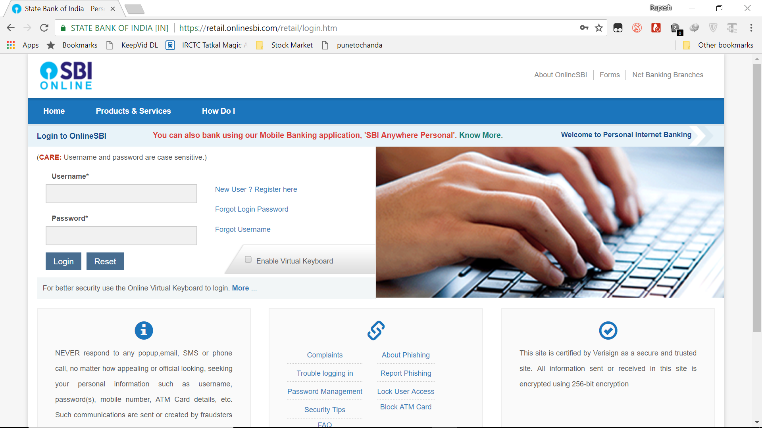
LOG IN YOUR USERNAME AND PASSWORD

Slide 38
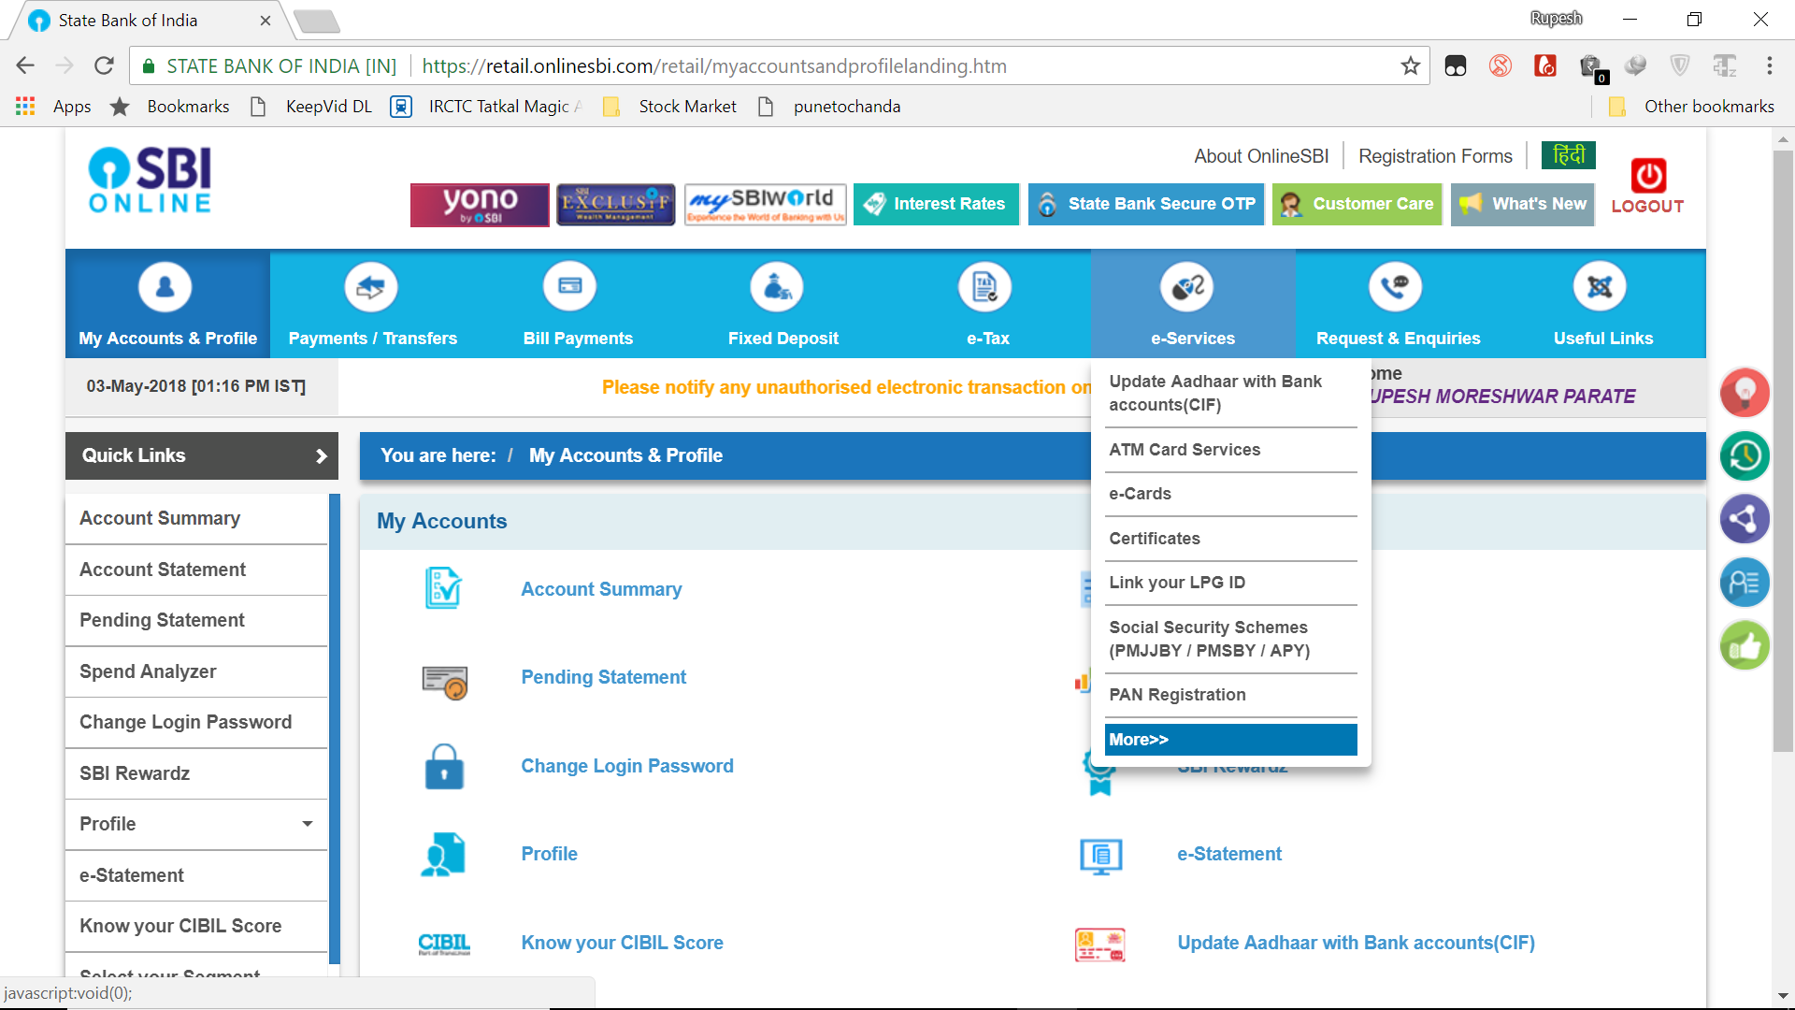
Click on e-Serices

Slide 39
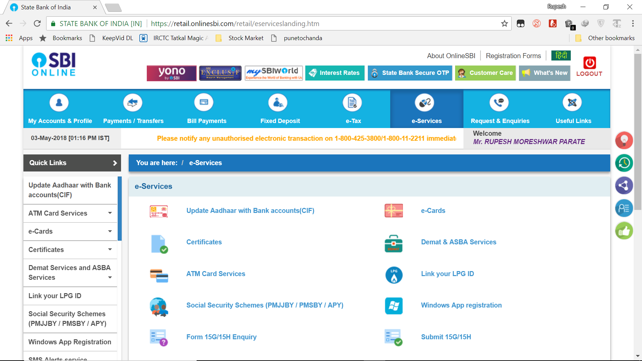
Click on Demat & ASBA Services

Slide 40
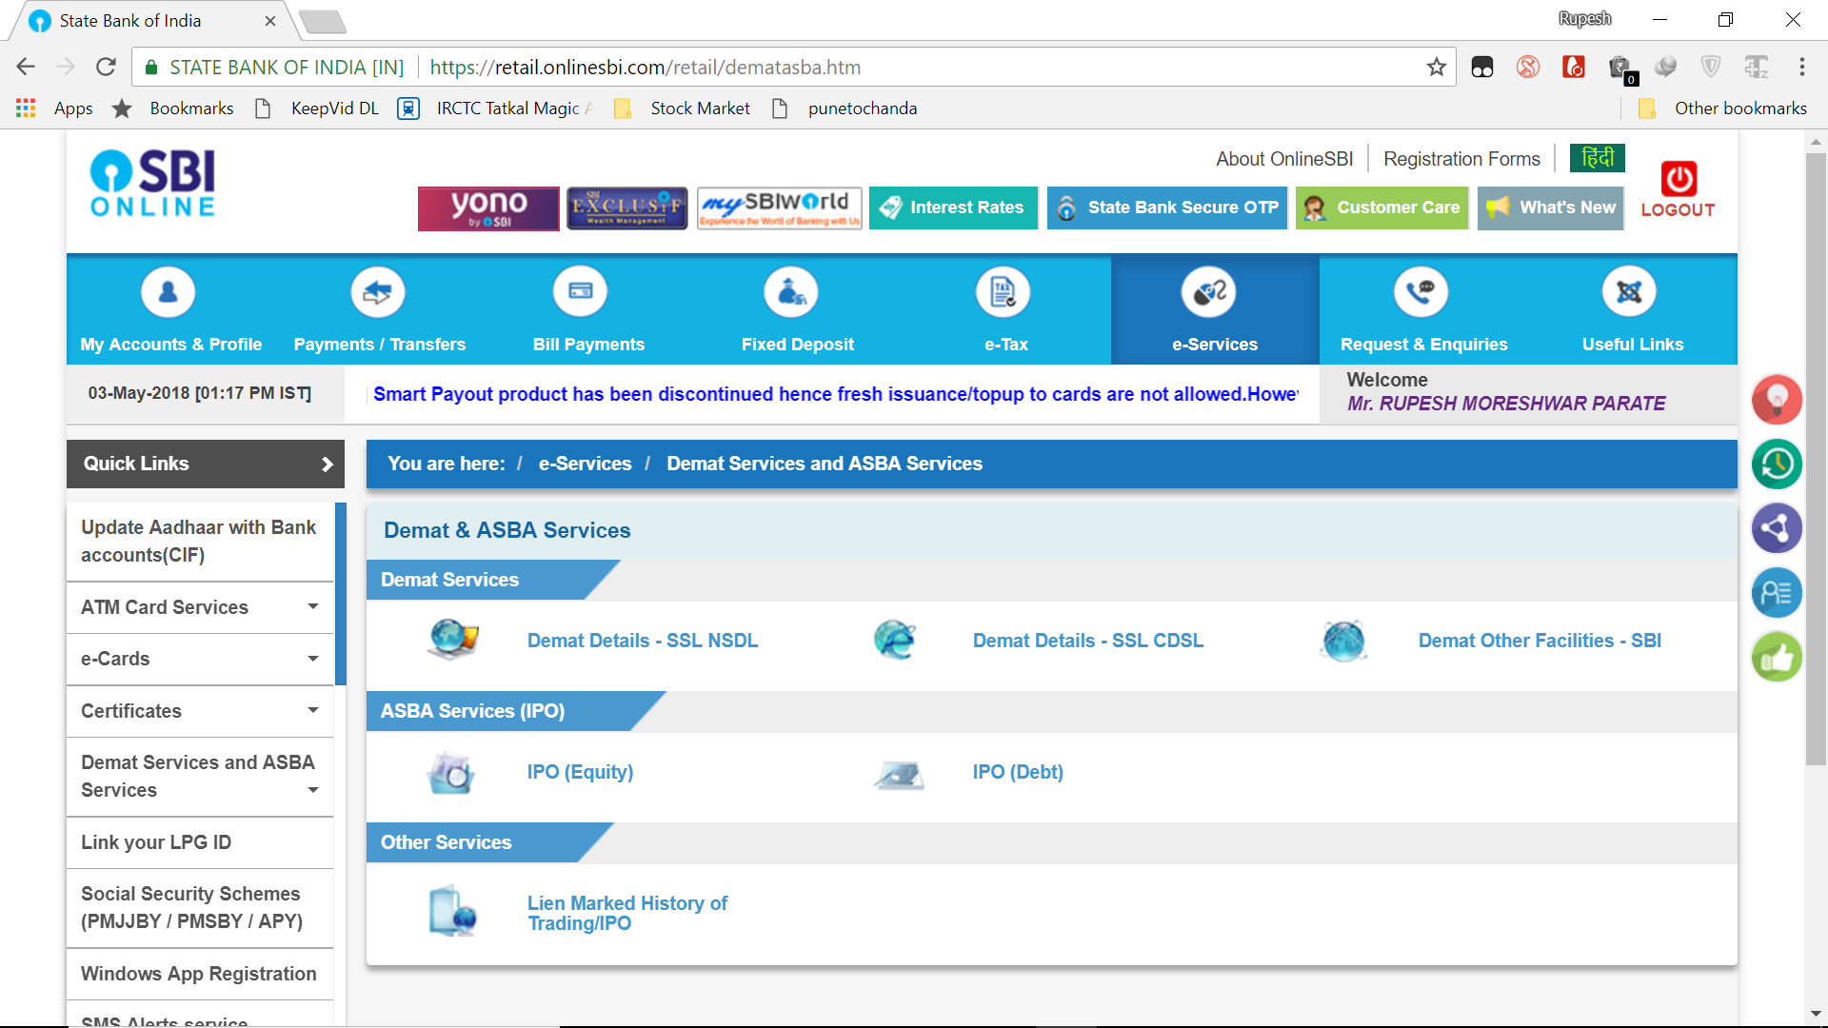
Click on IPO(Equity)

Slide 41
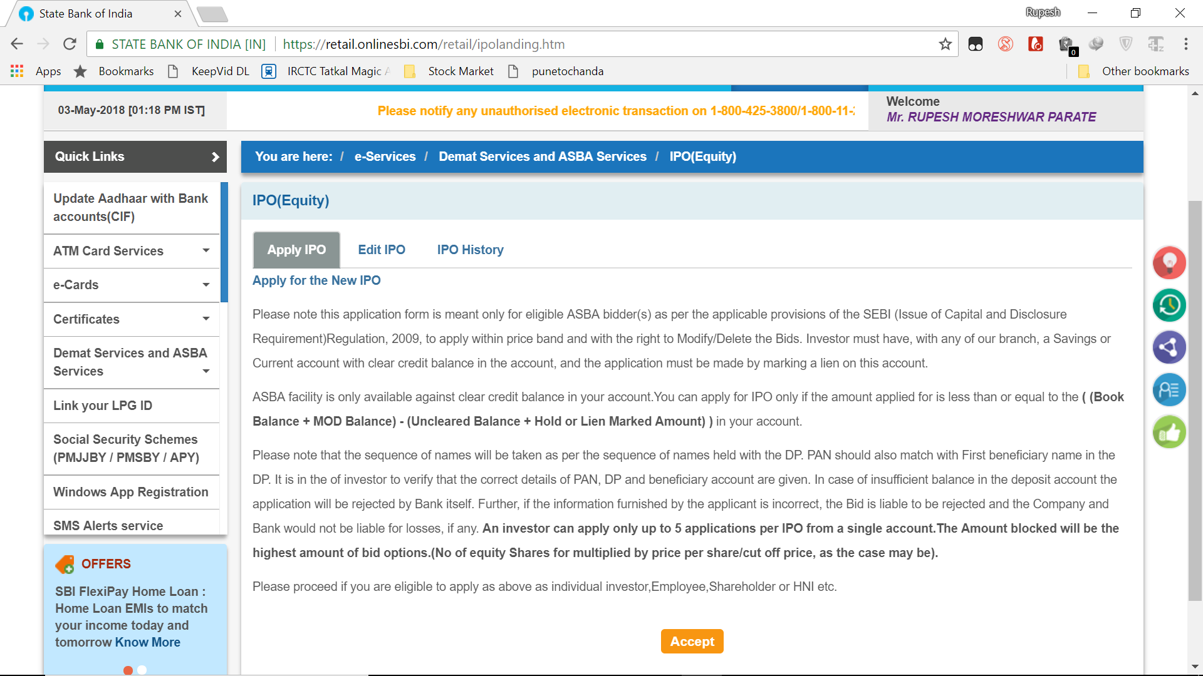
Click on Accept

Slide 42
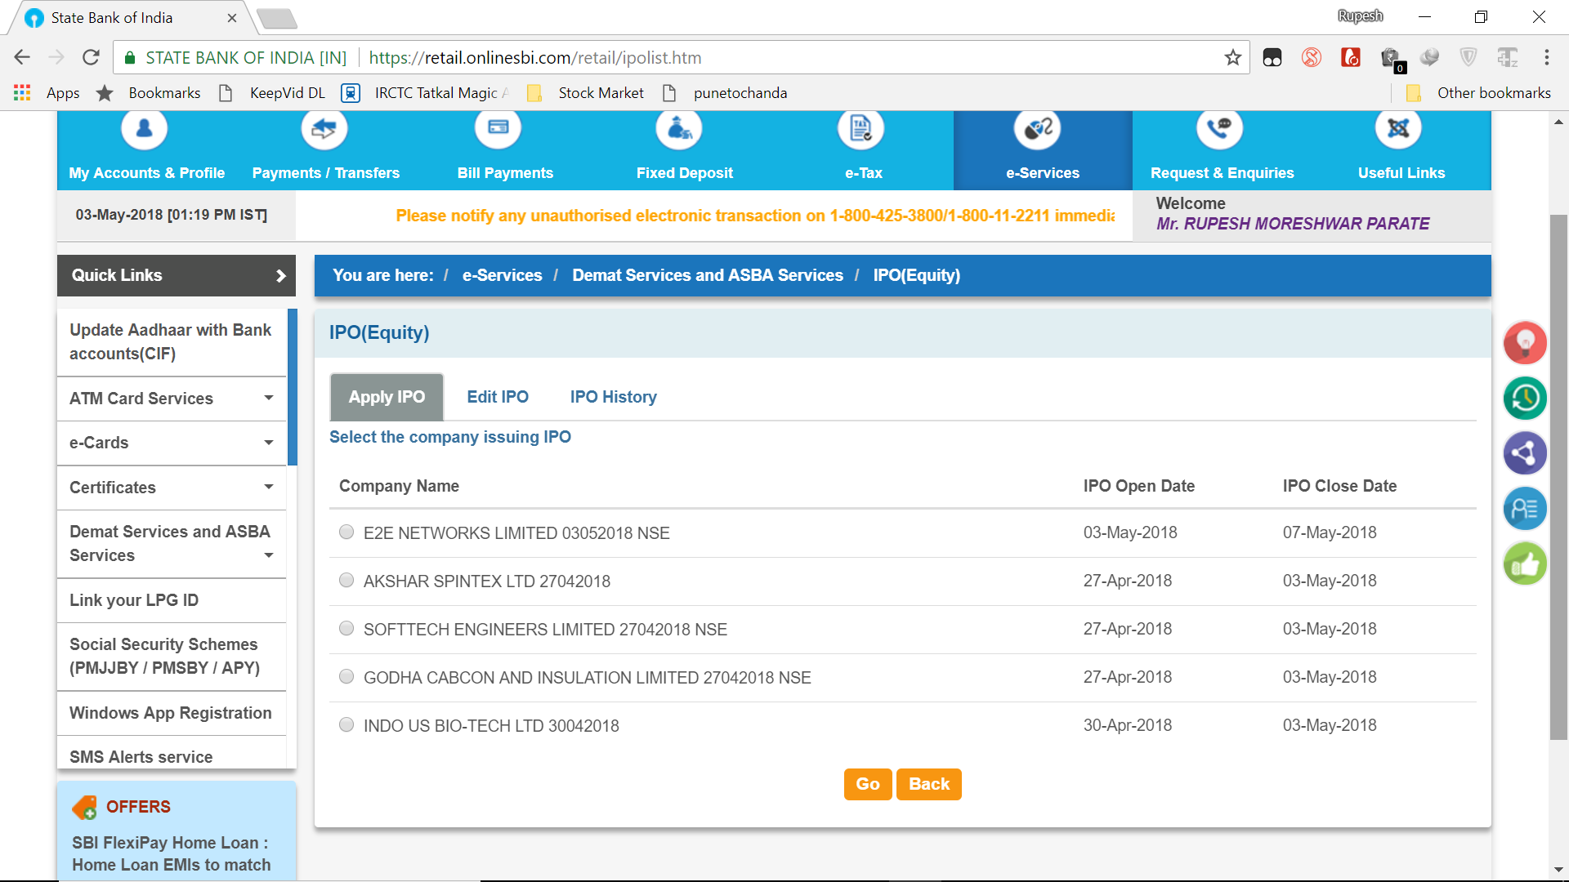
Select IPO
Click on Go

Slide 43
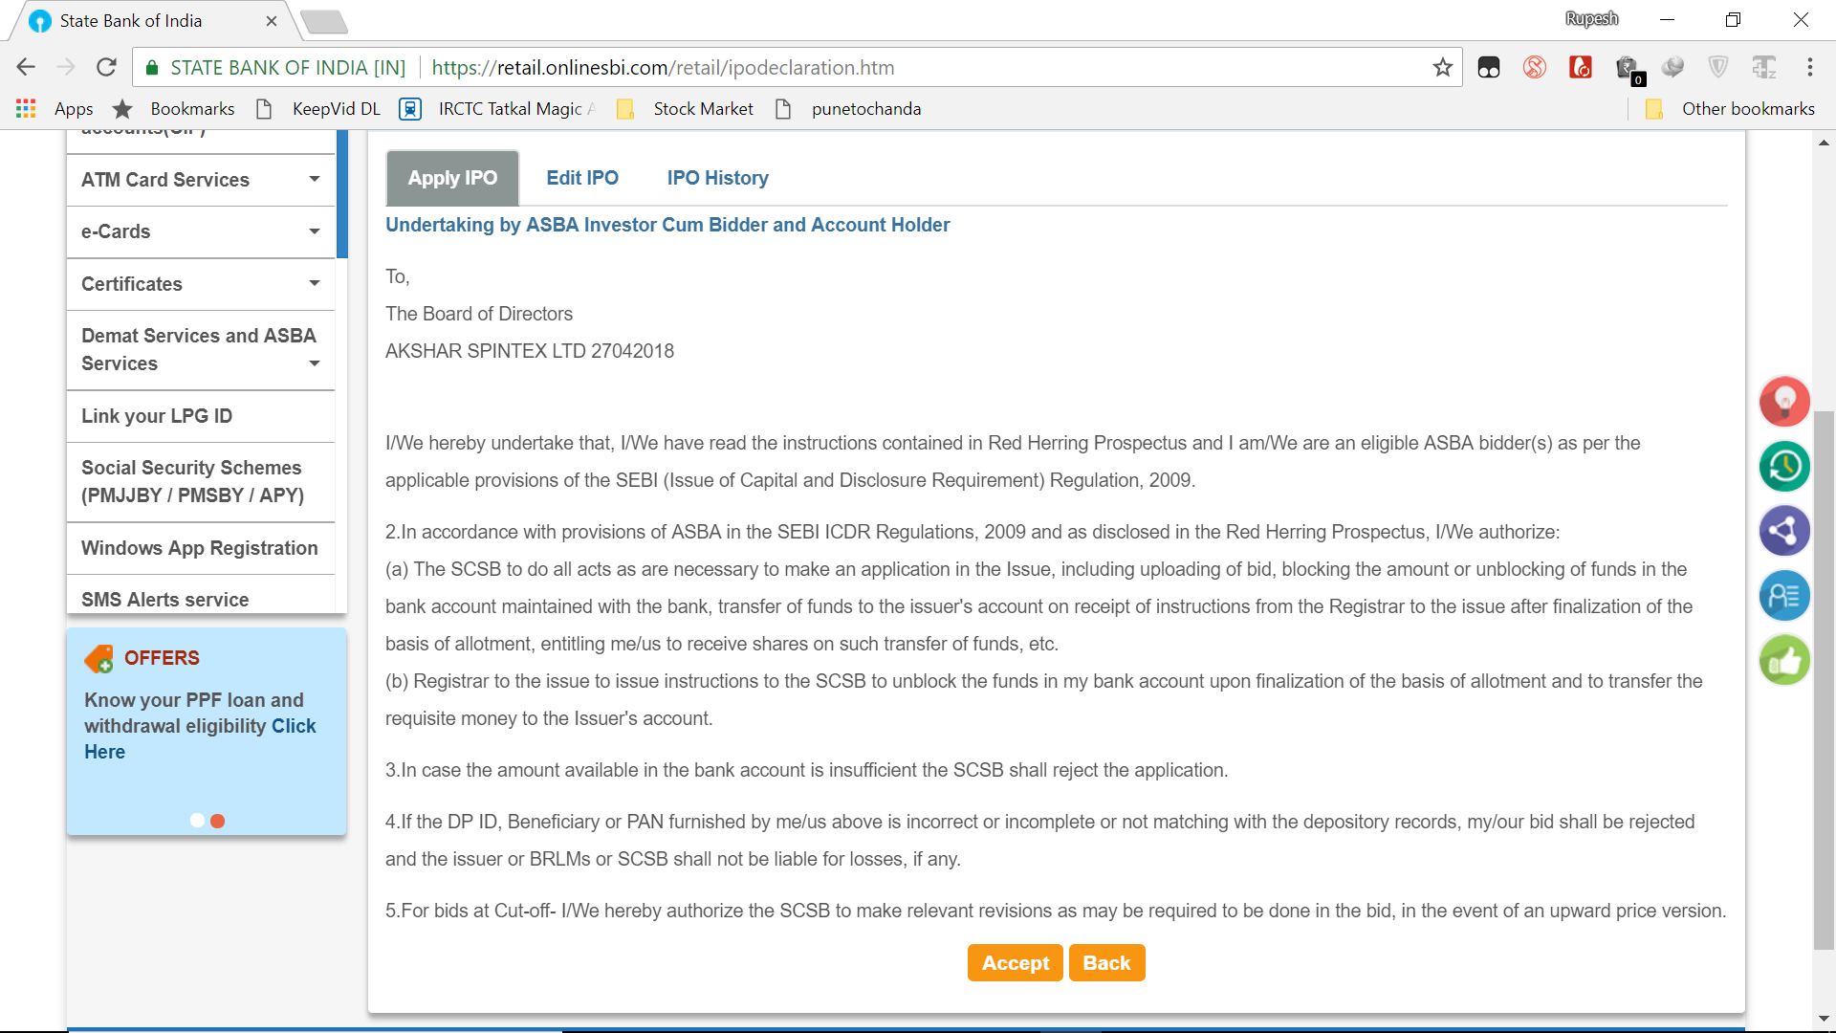
Click on Accept

Slide 44
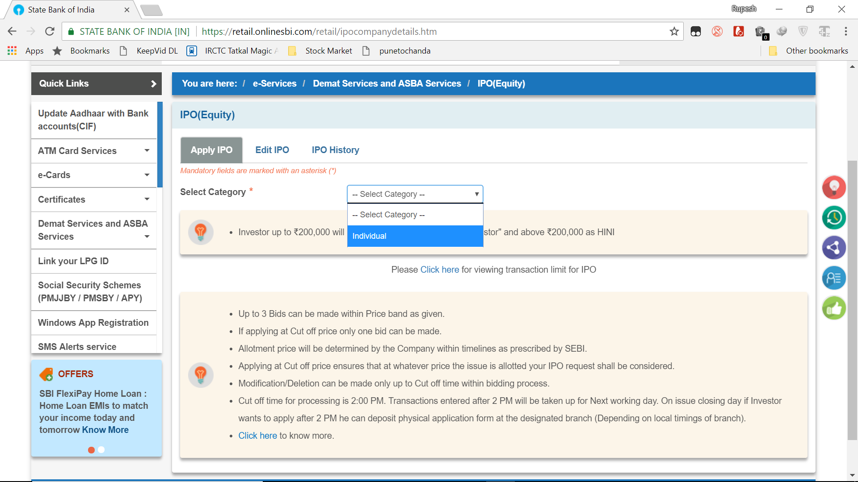
Select Individual option

Slide 45
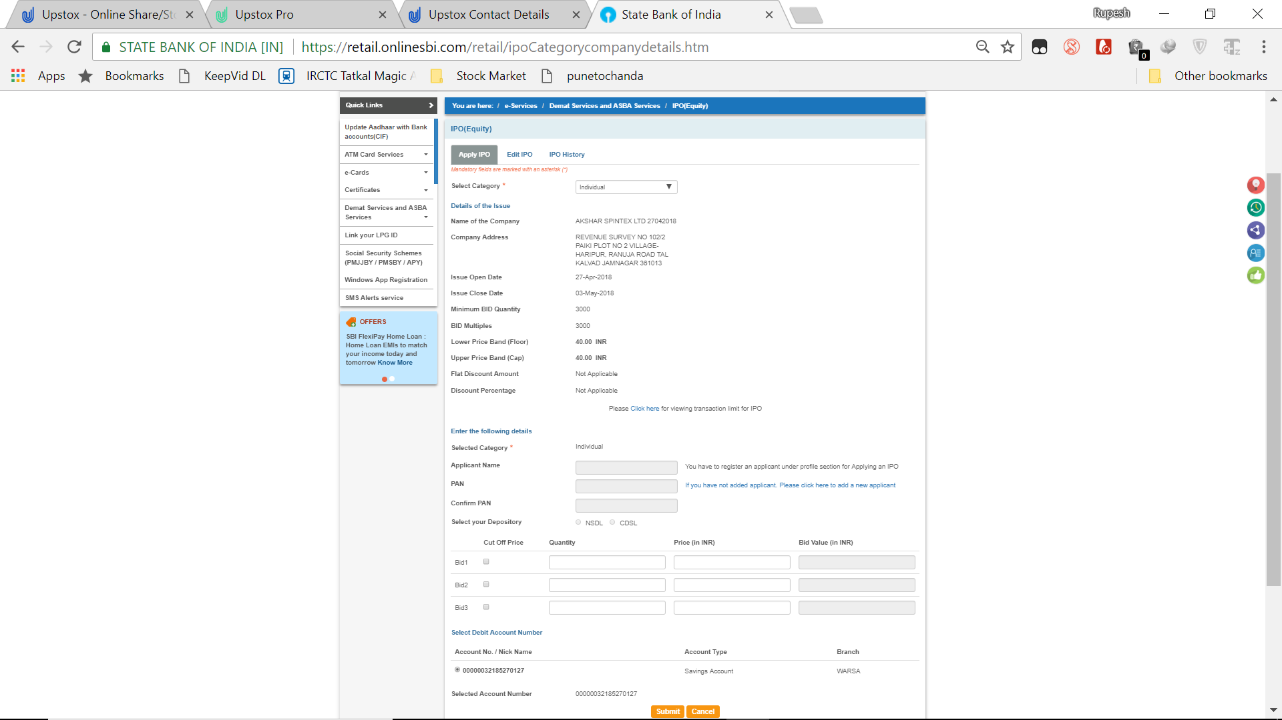
First time you have to register with bank for IPO buying

Slide 46
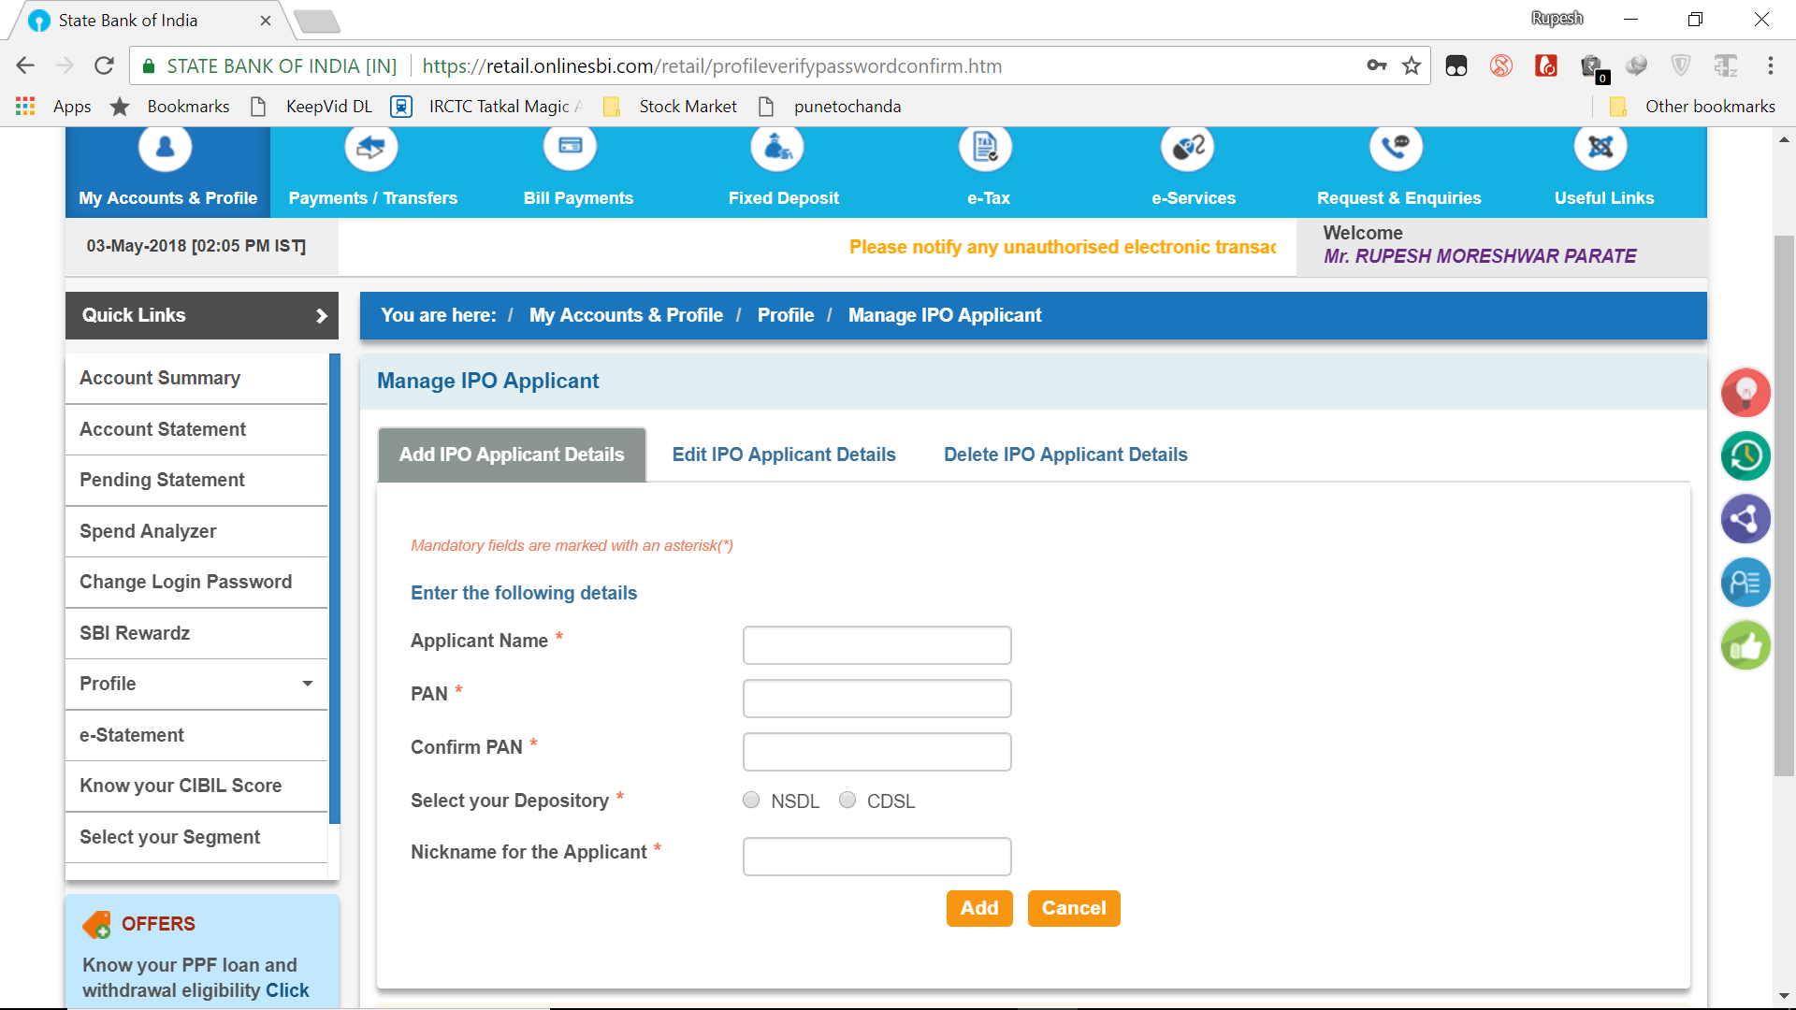
Fill all the details
Select CDSL for Upstox
Click on Add

Slide 47
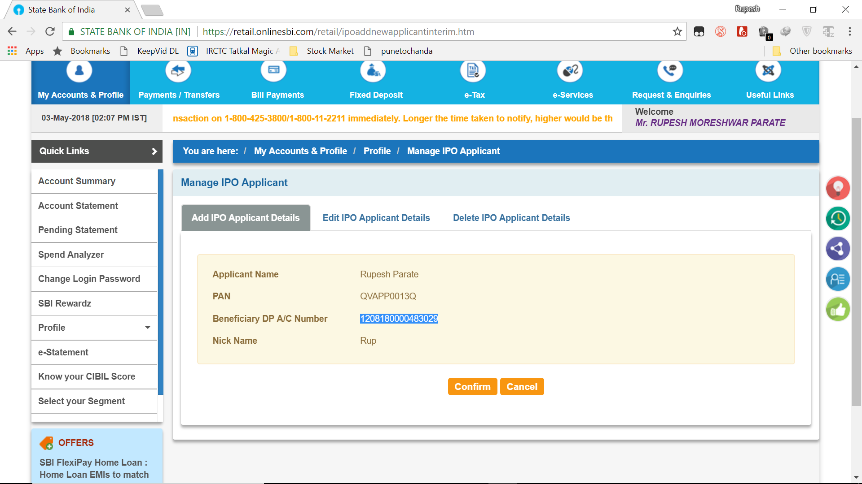
Ask Beneficiary DP A/C Number to your Broker
Click on Confirm

Slide 48
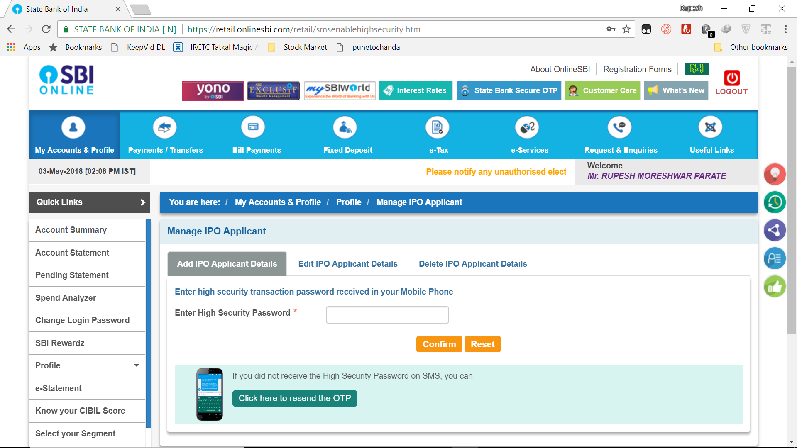
Enter your OTP

Slide 49
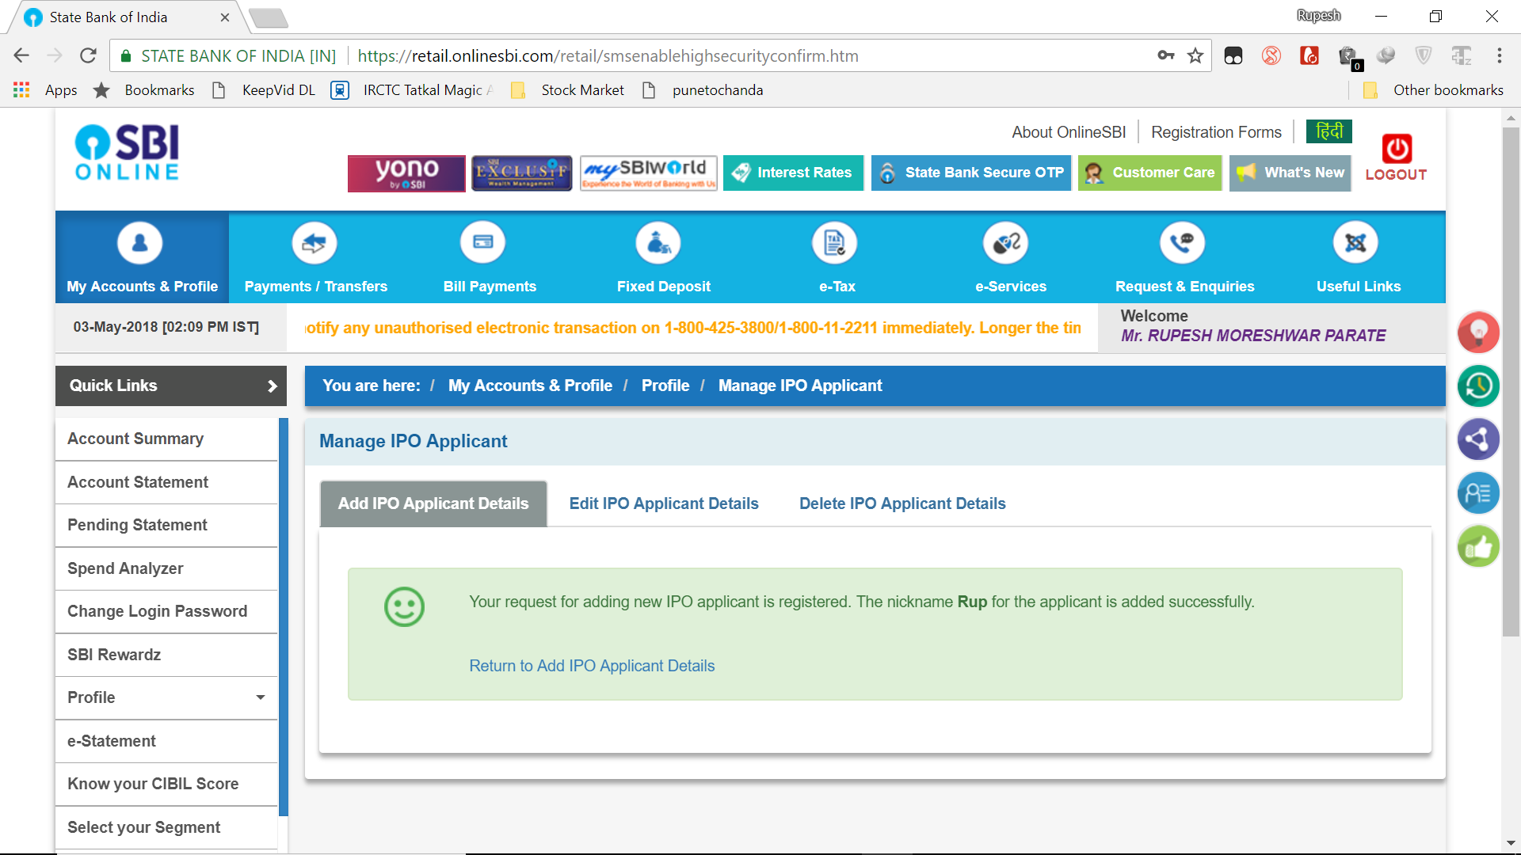
New IPO applicant is registered

Slide 50
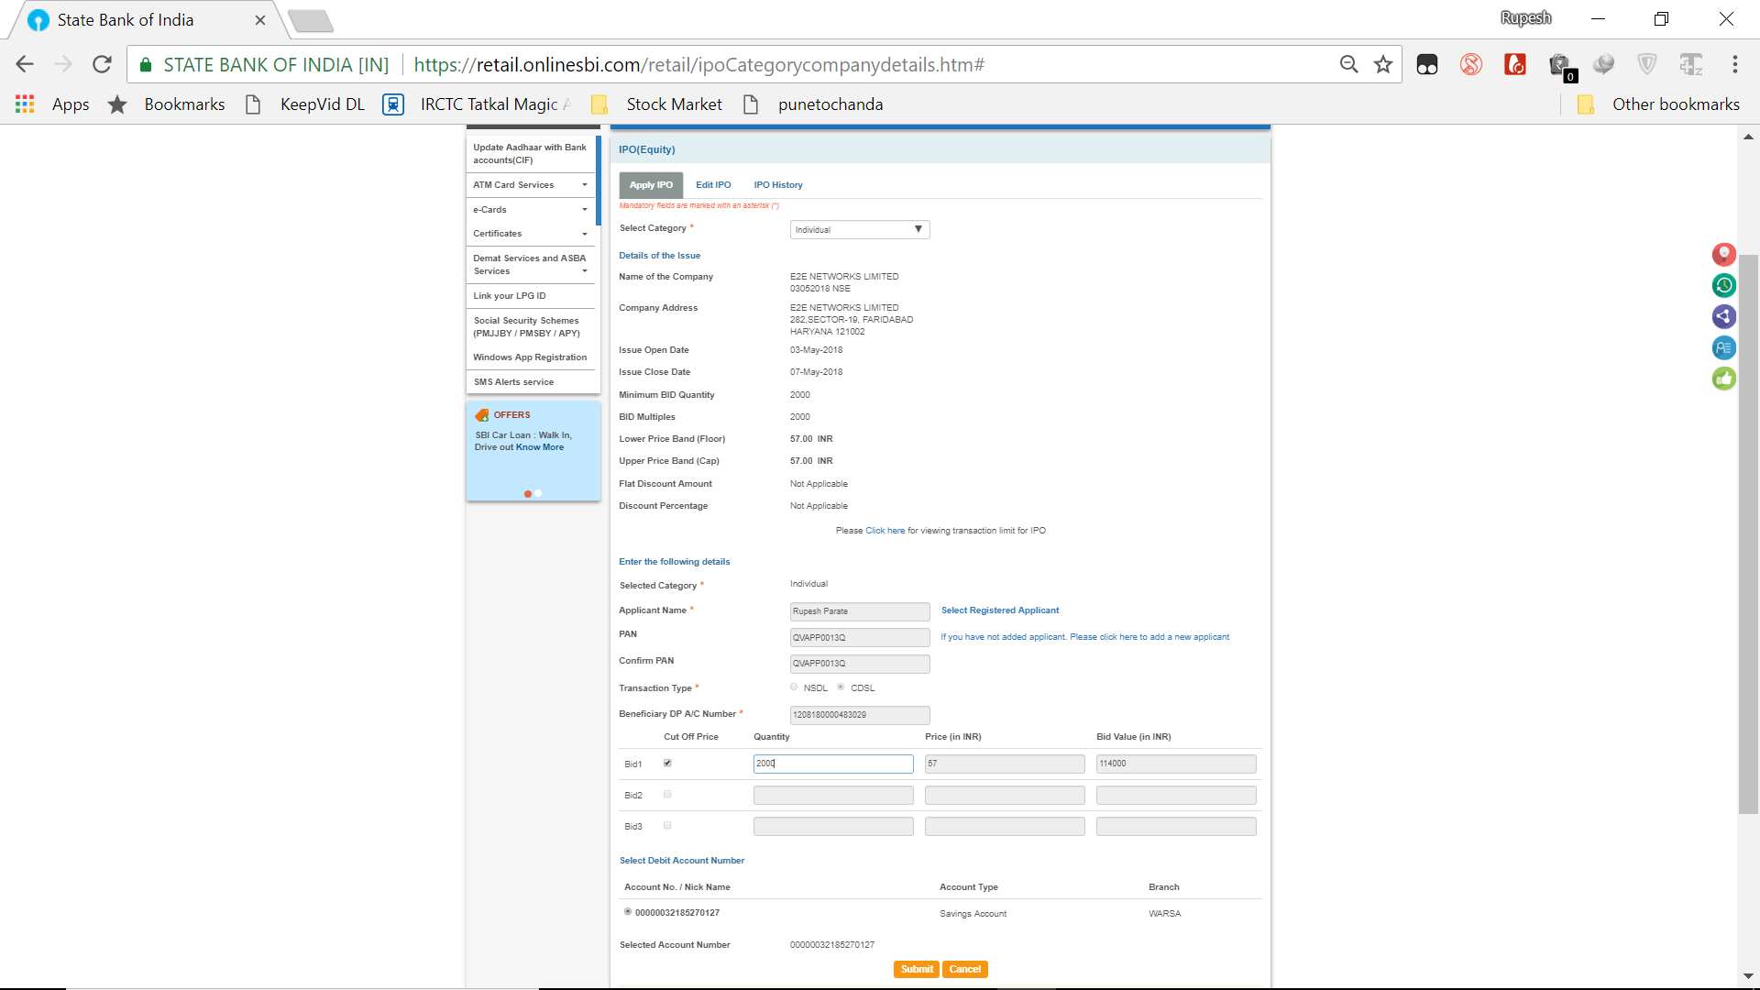
Select Register Applicant
Enter Bid Quantity

Slide 51
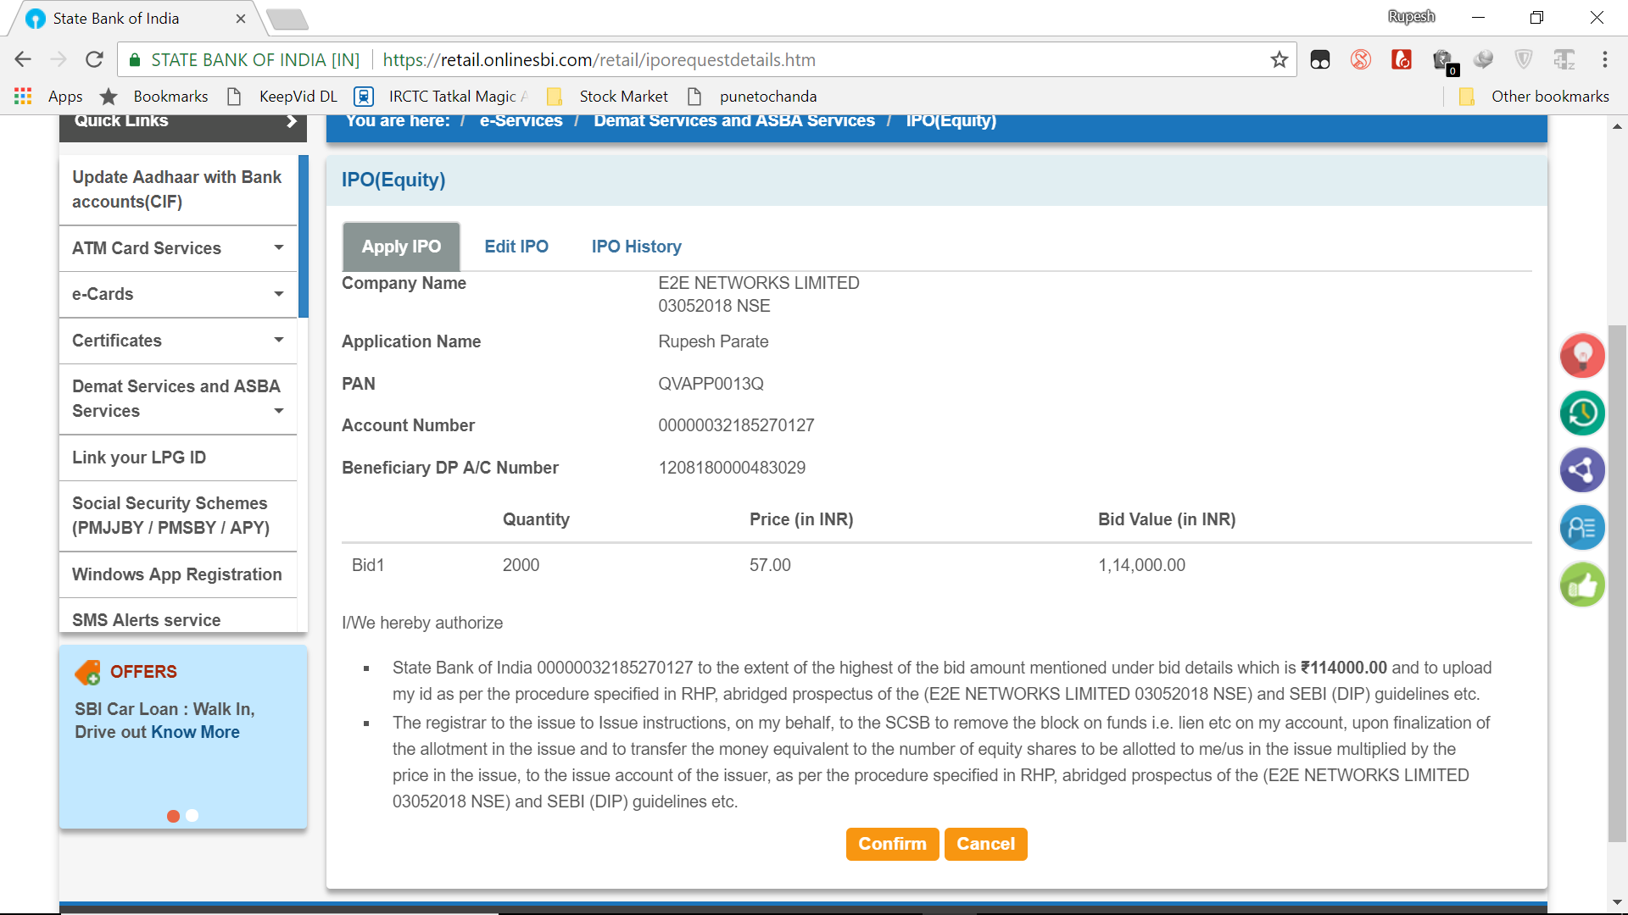
Click on Confirm

