Slide 1
TYPES OF ACCOUNTS
Accounts
D-Mat Account
Trading Account
Bank Account

Slide 2
TYPES OF ACCOUNTS
D-Mat Account
A Demat Account is an account that allows investors to hold their shares in an electronic form.
It can be used only for saving of shares and not for transaction.
Demat account is generally for the people who would like to invest in the market and hold the shares in the electronic form.
Trading Account
Account used for placing buy sell orders.
The main transaction of shares is done through the trading account.
Trading account is mostly for traders in derivative segments such as Index, stocks, Commodities, Currencies futures and Options and specially for those who trade in Cash segment..
Bank Account
A bank account is a financial account maintained by a bank for a customer.
A bank account can be a deposit account, a credit card account, a current account, or any other type of account offered by a financial institution

Slide 3
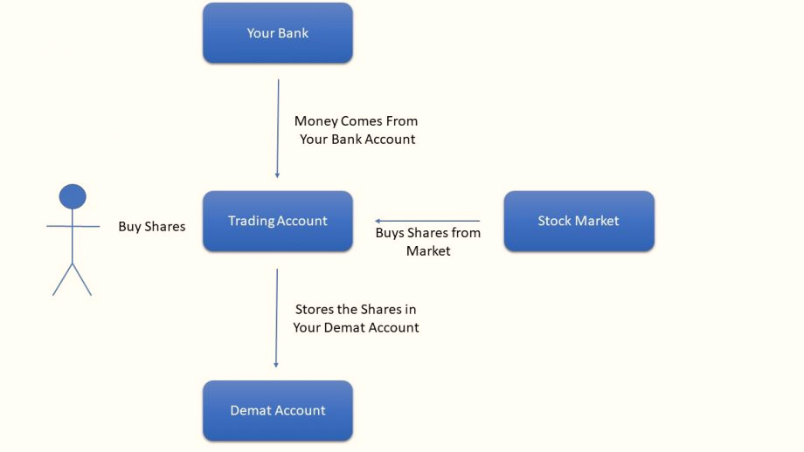
ROLE OF TRADING A/C, BANK A/C, D-MAT A/C

Slide 4
TYPES OF D-MAT
2-in- 1 Account
The 2-in- 1 trading account basically integrates the trading account and the Demat account.
If you open 2-in-1 account then you have linked your bank to your account.
3-in- 1 Account
The 3-in- 1 account is offered by brokers that have banking operations within the group.
3 in 1 account is usually open by trader or investor who are willing to invest in Stock market.
trading account provide you a platform or in simple term a website , using that you can place order to buy and sell.
Demat account is account where you keep your share in electronic form.
Saving account is where you keep your money. You integrate all 3 in one place and that will be a website (Like ICICI Direct is website too)

Slide 5
DISCOUNT BROKING & FULL-SERVICE TRADING ACCOUNTS
Full-Service Brokers/(Traditional Brokers)
Full-service brokers or traditional brokers are brokers who provide advisory and trading facilities in stocks, commodities and currencies.
These brokers charge commission in percentage terms on the total amount of trade clients execute.
Full-service brokers operate out of many offices and branches across the country, which clients can visit in case of any query. India Infoline is one of the leading full-service brokers in India.
ICICIDirect, Kotak Security, HDFC Sec, Sharekhan, MotilalOswal, India Infoline are some of the full-service brokers
Discount Brokers
Discount brokers just provide a trading platform to investors but no advisory.
Discount brokers charge low brokerage.
It offers trading experience in equity, derivatives, currencies and commodities at Rs 10/per trade (lowest in the industry), irrespective of the invested amount.
Over the last few years, discount brokers have established themselves in the market and are giving a neck-to-neck competition to full-service brokers who have been in the industry for quite a long time.
Discount brokers is RKSV UPSTOX.

Slide 6
BENEFITS OF TRADING WITH DISCOUNT BROKERS
Zero/Low Commissions: Discount brokers will carry your buy-sell orders at a very low commission rate.
Powerful Analysis Tools: Discount brokers can deliver all the required charts and tools to help a trader conduct proper prior research. Again, Upstox offers more than 100 charts and other tools to smartly analyze your stocks and trade intelligently and independently. There’s always value to grab.
Efficiency: Time is everything in the markets. With new age, fast platforms offered by secure and stable discount brokers, you can place and execute orders instantly.
Ease of registration: Discount brokers are more likely to be aligned with new technologies - such as Aadhaar-based eKYC registrations that eliminate paperwork and reduce costs.

Slide 7
DOCUMENTS REQUIRED FOR D-MAT
Aadhaar and PAN card are mandatory for Indian residents
Identity proof :
Aadhaar
Any one of the following photo cards:
  Passport
  PAN card
  Voter Id card
  Govt ID
Address Proof :
Aadhaar
Any one of the following documents with current residence address:
  Passport
  Driving license
  Phone bill
  Electricity / other utility bill
  Rental agreement
  Latest other bank / credit card statement
One recent passport-sized photograph

Slide 8
ASK RATE & BID RATE
Bid price:
Bid price is buyers price.
It represents the maximum price that a buyer is willing to pay for a security.
Ask price:
Ask price is sellers price.
Represents the minimum price that a seller is willing to receive.

Slide 9
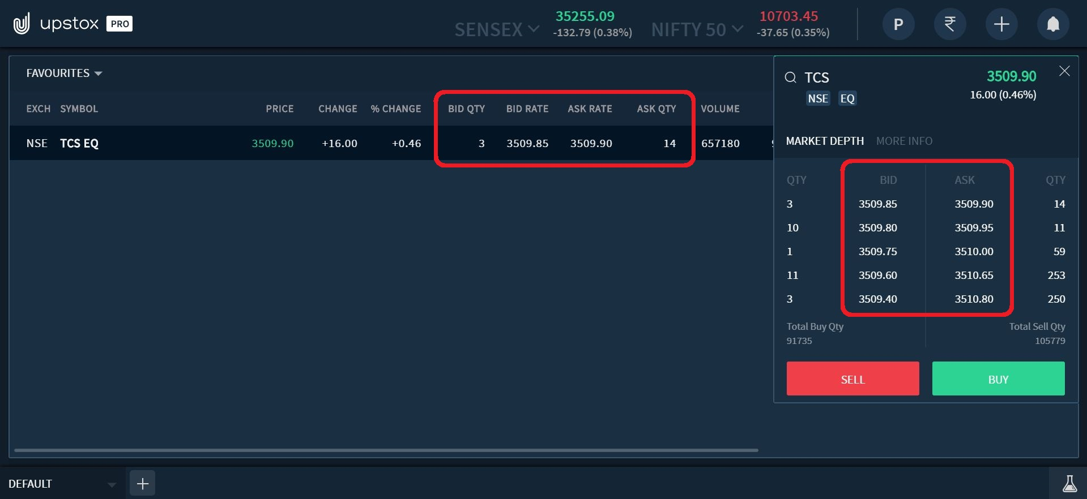

Slide 10
OPEN, CLOSE, HIGH, LOW
What is open price?
The opening price is the price at which a security first trades upon the opening of an exchange on a given trading day.
What is high price?
A security's intraday high trading price. Today's high is the highest price at which a stock traded during the course of the day.
What is low price?
A security's intraday low trading price. Today's low is the lowest price at which a stock trades over the course of a trading day. Today's low is typically lower than the opening or closing price.
What is close price?
The closing price is the final price at which a security is traded on a given trading day.

Slide 11
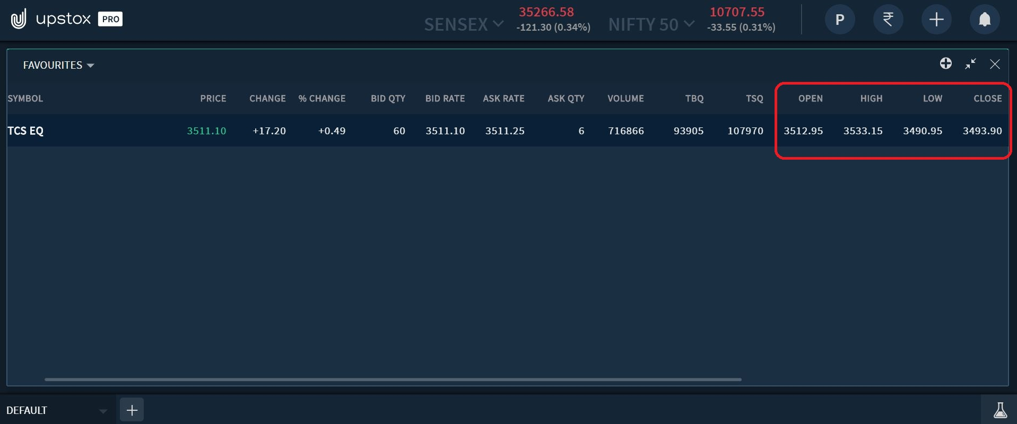

Slide 12
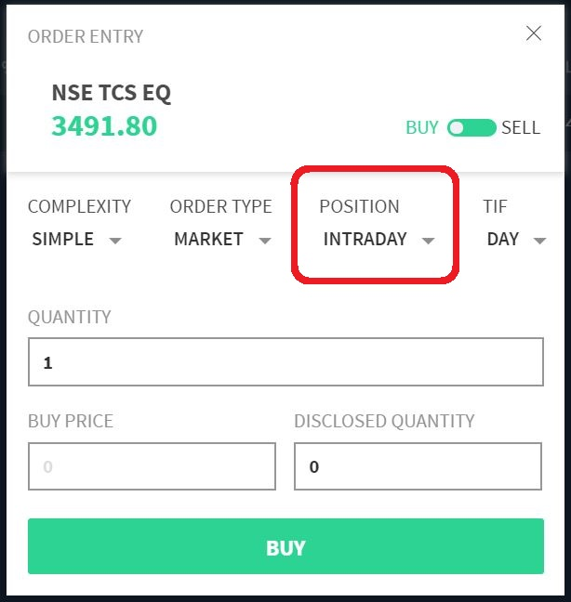
INTRADAY
Buying and selling within a trading day.
You get a higher leverage compared to delivery trading.
Open positions get auto square off before the closing of the day.
No dividend and bonus.
Low brokerage.
Taxable.
Shortsell.
Intraday is trading tool.

Slide 13
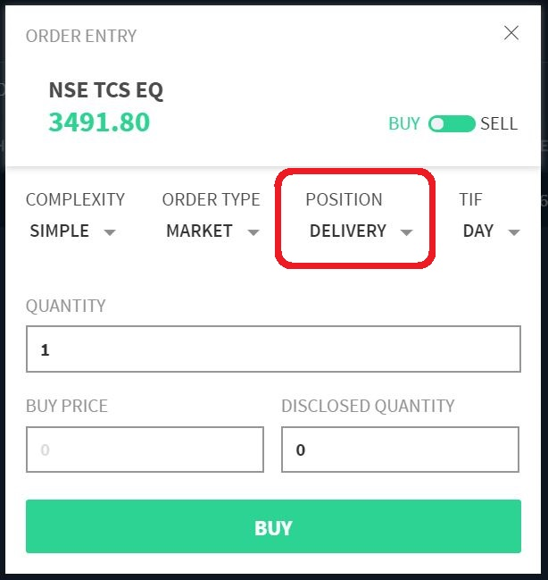
DELIVERY/POSITIONAL
When you purchase shares and hold them overnight, then you take delivery of the shares and hence, this is called Delivery Trading.
we follow a T + 2 settlement cycle when trading stocks.
High brokerage as compared to intraday.
Benefits of dividend and bonus.
Tax-free after 1 year holding (upto 1 lakh).
Convert delivery into intraday.
Higher leaverage.
You can shorsell but you have to buy same day otherwise penaulty.
Delivery trading is investment tool.

Slide 14
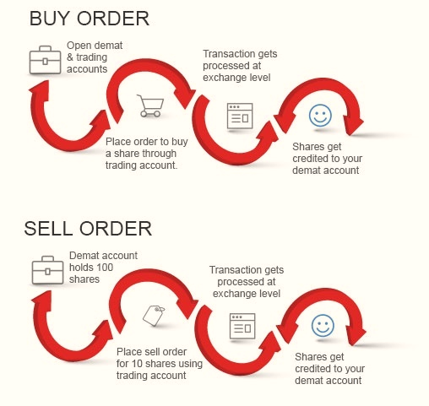
ORDERS
Orders
Buy Order
Buy is buyers order
Sell Order
Sell is sellers order

Slide 15
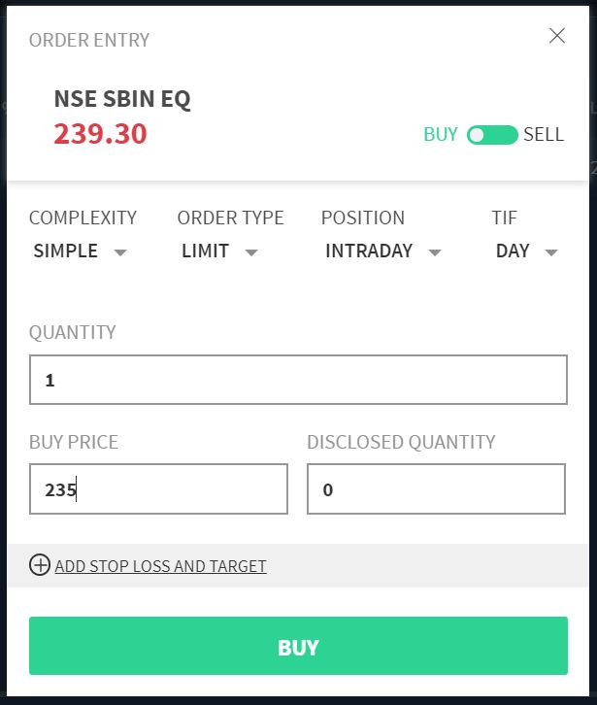
DIFFERENT TYPES OF ORDERS
Limit Order:-
A Limit Order is when you wish to purchase or sell a scrip at a certain price.
Limit order can be modified, cancel or delete anytime but before execution.
In case of Buy limit order less than current market price
In case of Shortsell limit order greater than market price.
Limit order is specifically design for increase your profit margin.

Slide 16
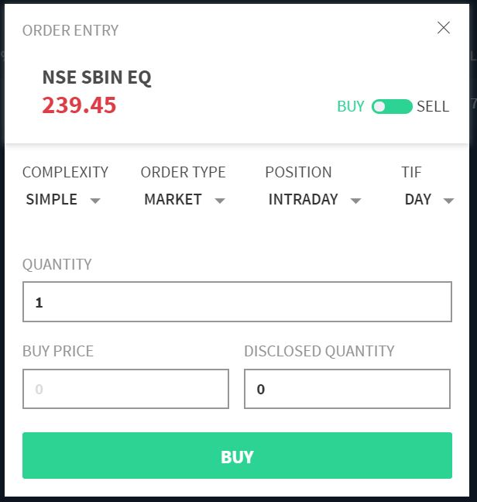
Market Order:-
A market order is a buy or sell order to be executed immediately at current market prices.
A market order will be executed at whatever market rate is prevalent at the time the order is placed.

Slide 17
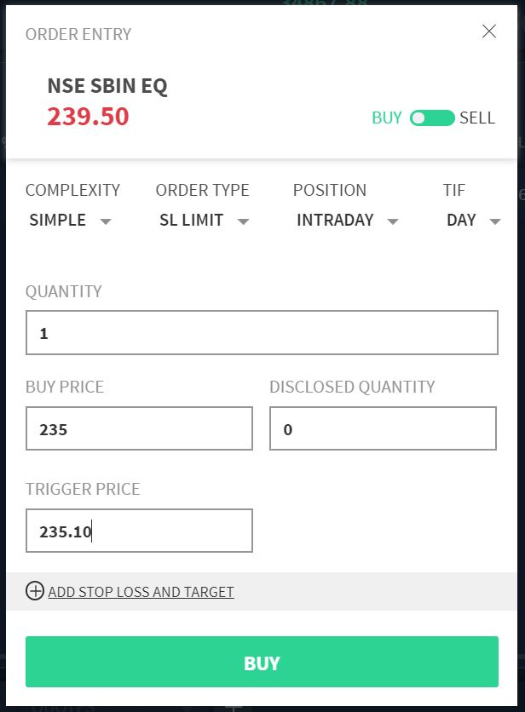
Stop Loss Order:
The primary objective of a stop loss order as the name suggests is to STOP A LOSS.
The stop loss order is primarily meant to limit your loss on a scrip that you have already purchased.
The price you mention in the stop loss order is the highest risk that you are ready to take as loss on that scrip.
A stop loss order can be a limit order or a market order.
In case of Buy your stoploss order anytime less than limit order.
In case of Shortsell your stoploss order anytime higher than limit order

Slide 18
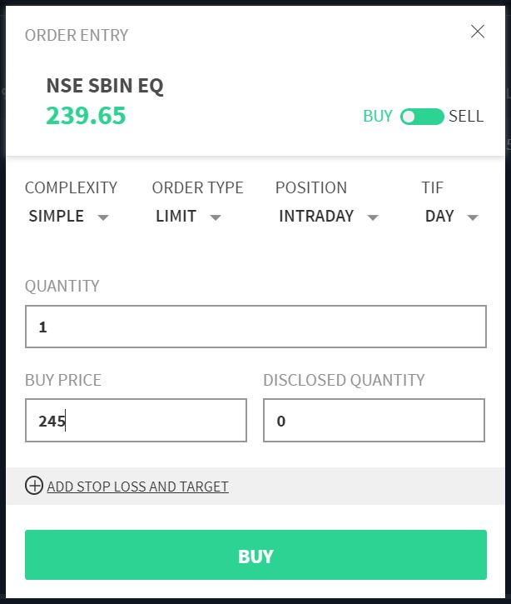
Target Order
It is price where you want to square off your position by booking profits.
In case of Buy your target order anytime higher than limit order
In case of Shortsell your target order anytime less than your limit order

Slide 19
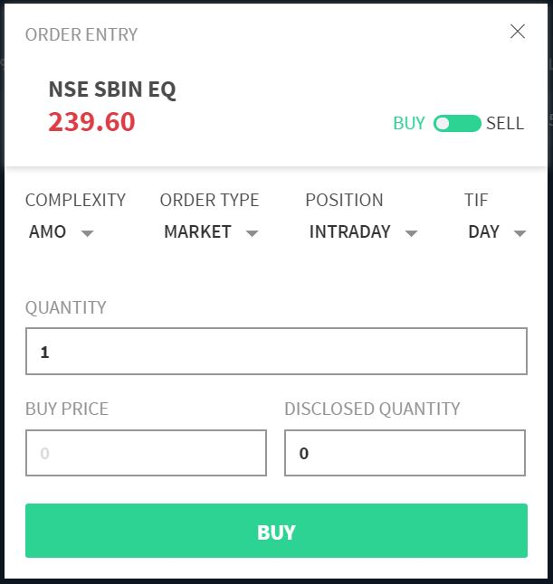
After Market Order (AMO):-
AMO or After Market Order is for those people who are busy during market hours but wish to participate.
You can plan your orders at leisure after researching about the markets before the market opens and place an order after the market closes.
You can place the order between 6:30 PM and 12:00 AM or between 4:00 AM and 9:00 AM.
The after market order will be executed at 9:15 AM at the start of the next trading day.

Slide 20
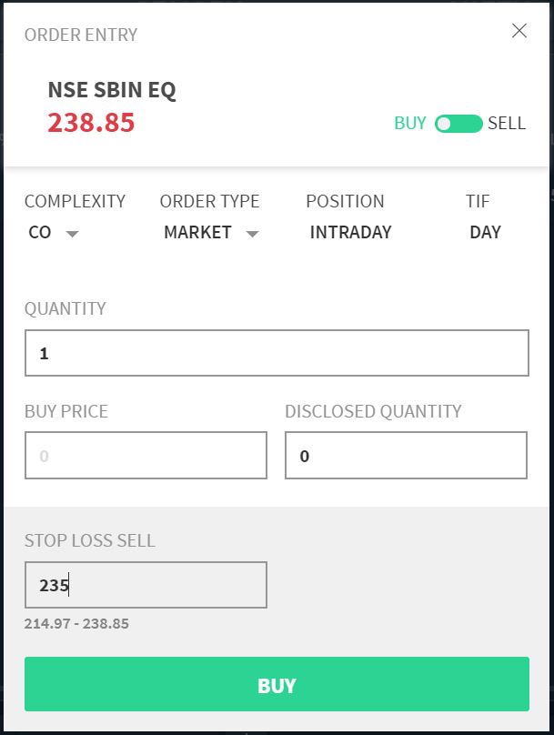
Cover Order(CO):-
A Cover Order is any market order which is placed along with a Stop Loss Order.
In a cover order you get to define the maximum loss that you can bear. The cover order has a major advantage in terms of margin.
Since you are ready to bear only a certain loss your losses are limited on that order. This means you need to pay only the amount of loss you wish to bear and not the entire amount.
For example:- if you are buying a stock at ₹100 & the maximum loss that you wish you bear is ₹5 then you order will get closed if the stock reached ₹95 (₹100 - ₹5). You also just have to pay ₹5 to place this order. Hence you get a major advantage in a cover order in terms of margin. Just like all intraday orders we close the cover order position at 3:15 PM.

Slide 21
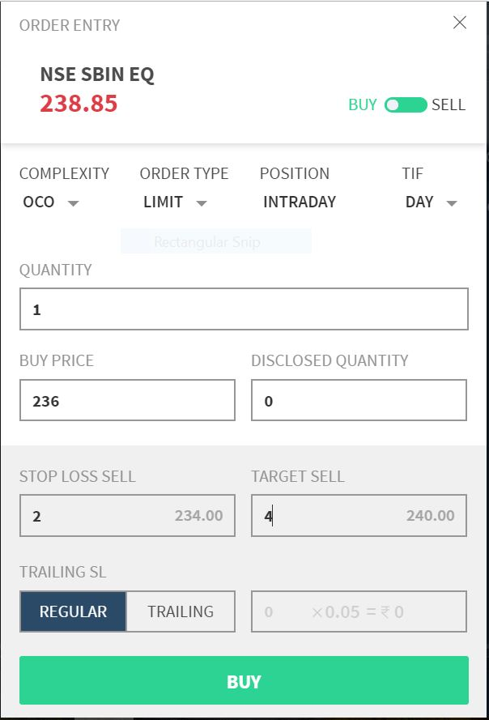
One Cancels Other (OCO):-
The one cancels the other order or sometimes known as bracket order is three legged intraday order.
The first leg of the OCO is buying or selling the actual scrip.
The 2nd leg is the stop loss just like a cover order.
The 3rd leg is a take away profit order.
This means that if a stock reaches a certain price in profit your order automatically gets squared off and you make the profits you intended to make.
The margin benefits in an OCO order are the same as that of a cover order. Also like all intraday orders the order gets squared off at 3:15pm at the prevalent market price.

Slide 22
CASE STUDY
The current market price of Reliance is 998. if you want to Shortsell then what will be the limit, target and stoploss?
Order Type | Buy/Sell | Price
Limit | Sell | 1010
Target | Buy | 990
Stoploss | Buy | 1020
In case of Shortsell your limit order anytime higher than CMP
In case of Shortsell your target order anytime less than your limit order
In case of Shortsell your stoploss order anytime higher than limit order

Slide 23
CASE STUDY
The current market price of Reliance is 998. if you want to Buy then what will be the limit, target and stoploss?
Order Type | Buy/Sell | Price
Limit | Buy | 990
Target | Sell | 1010
Stoploss | Sell | 980
In case of Buy your limit order anytime less than CMP
In case of Buy your target order anytime higher than limit order
In case of Buy your stoploss order anytime less than limit order.

